Slide 1


FPT SOFTWARE
Machine Learning Fundamentals
10/02/18

Slide 2
Supervised Learning
Lecture 2: Supervised Learning
Outline:
Classification and Regression
Inductive Learning
Decision Trees
Bayesian Learning
Neural Networks
Model Ensembles
Learning Theory
Support Vector Machine
Project Assignment

Slide 3
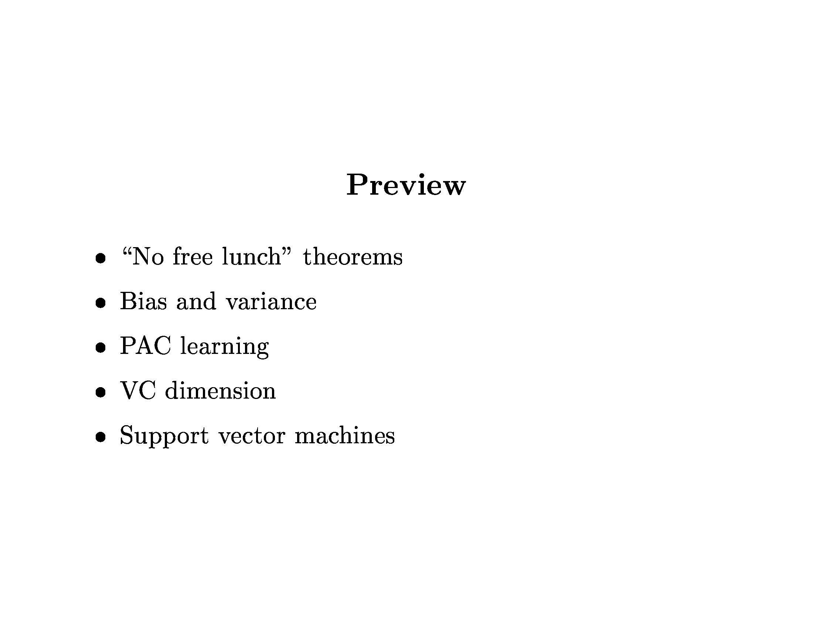
Learning Theory

Slide 4
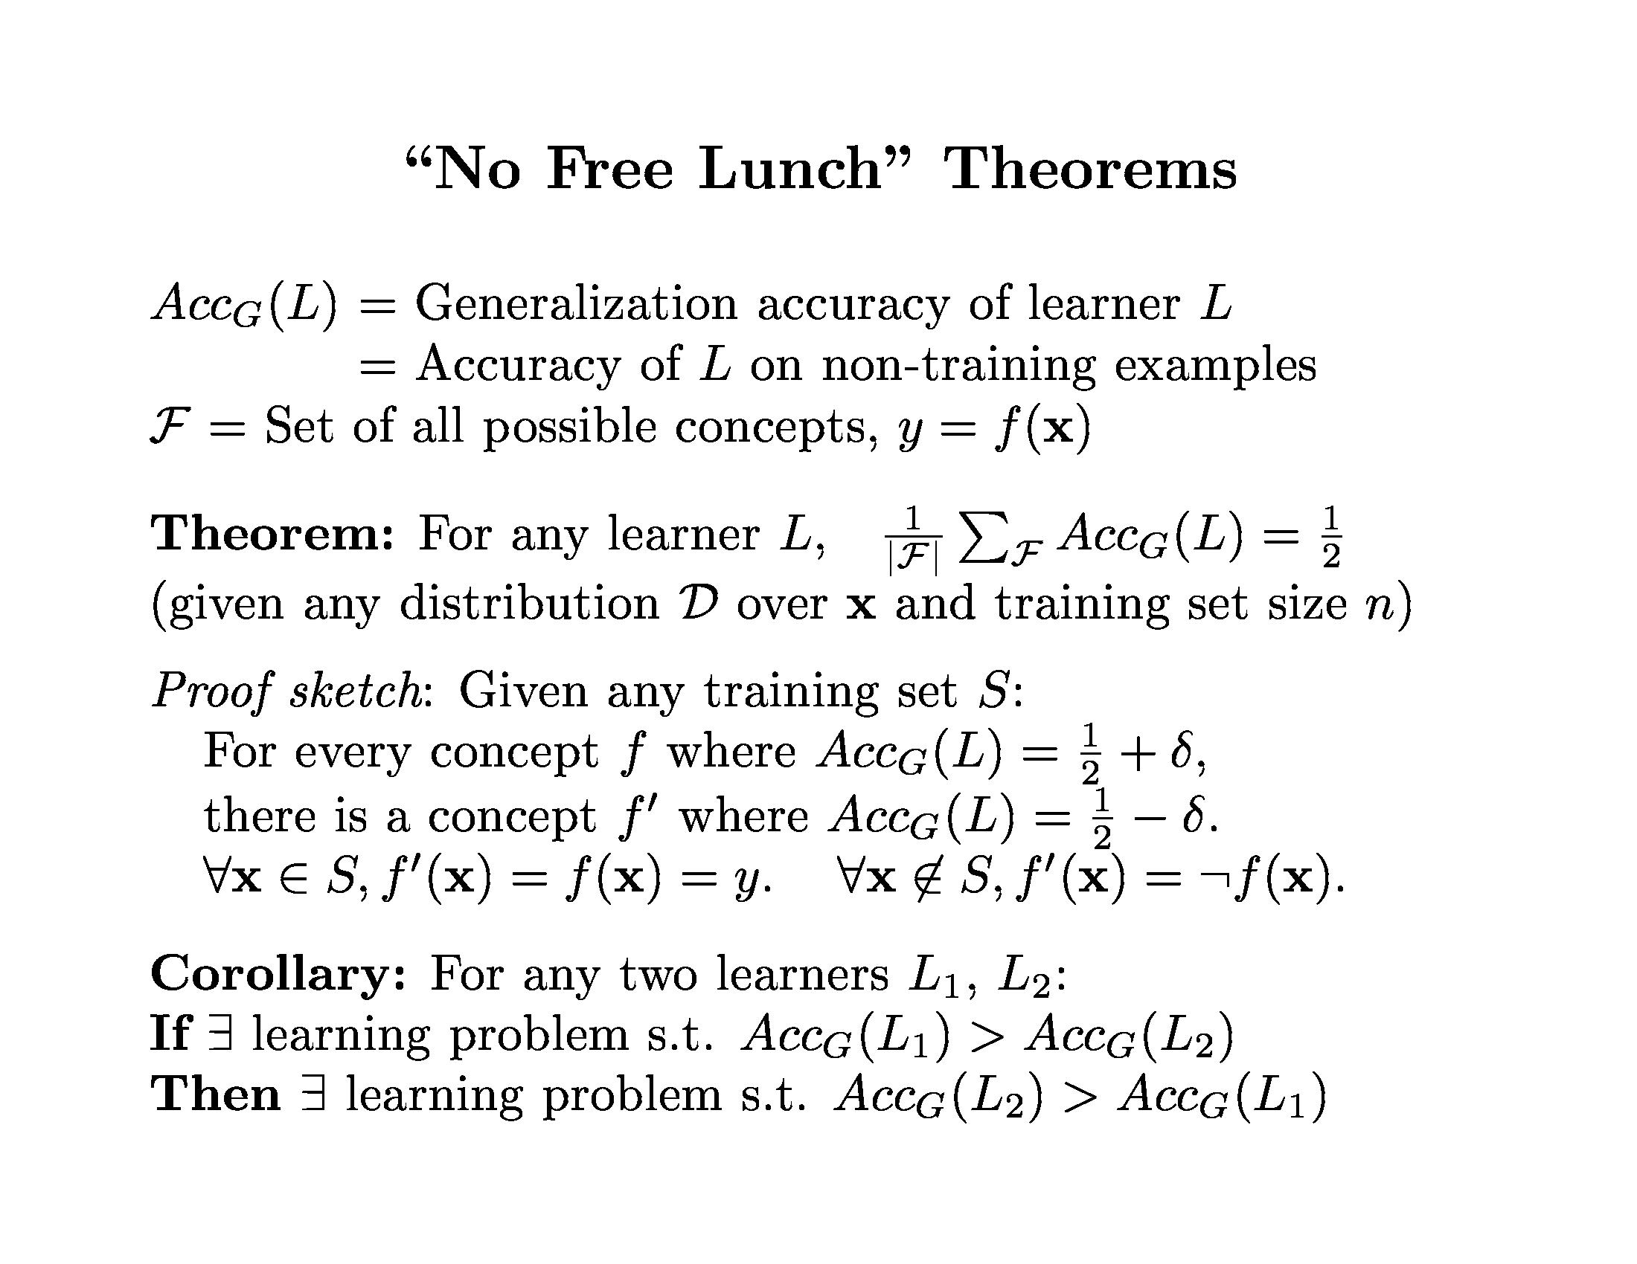
Learning Theory

Slide 5
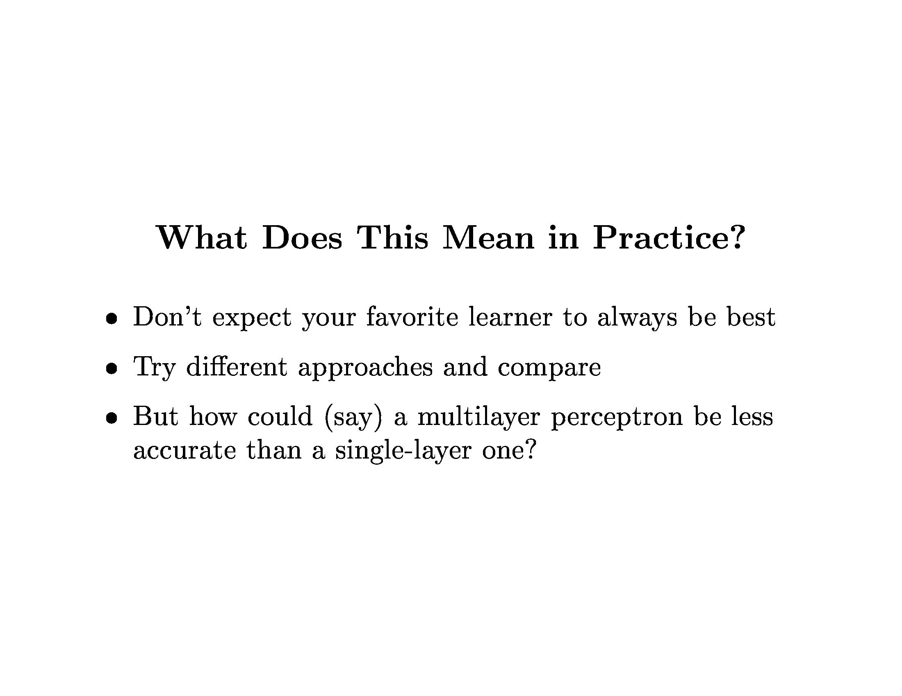
Learning Theory

Slide 6
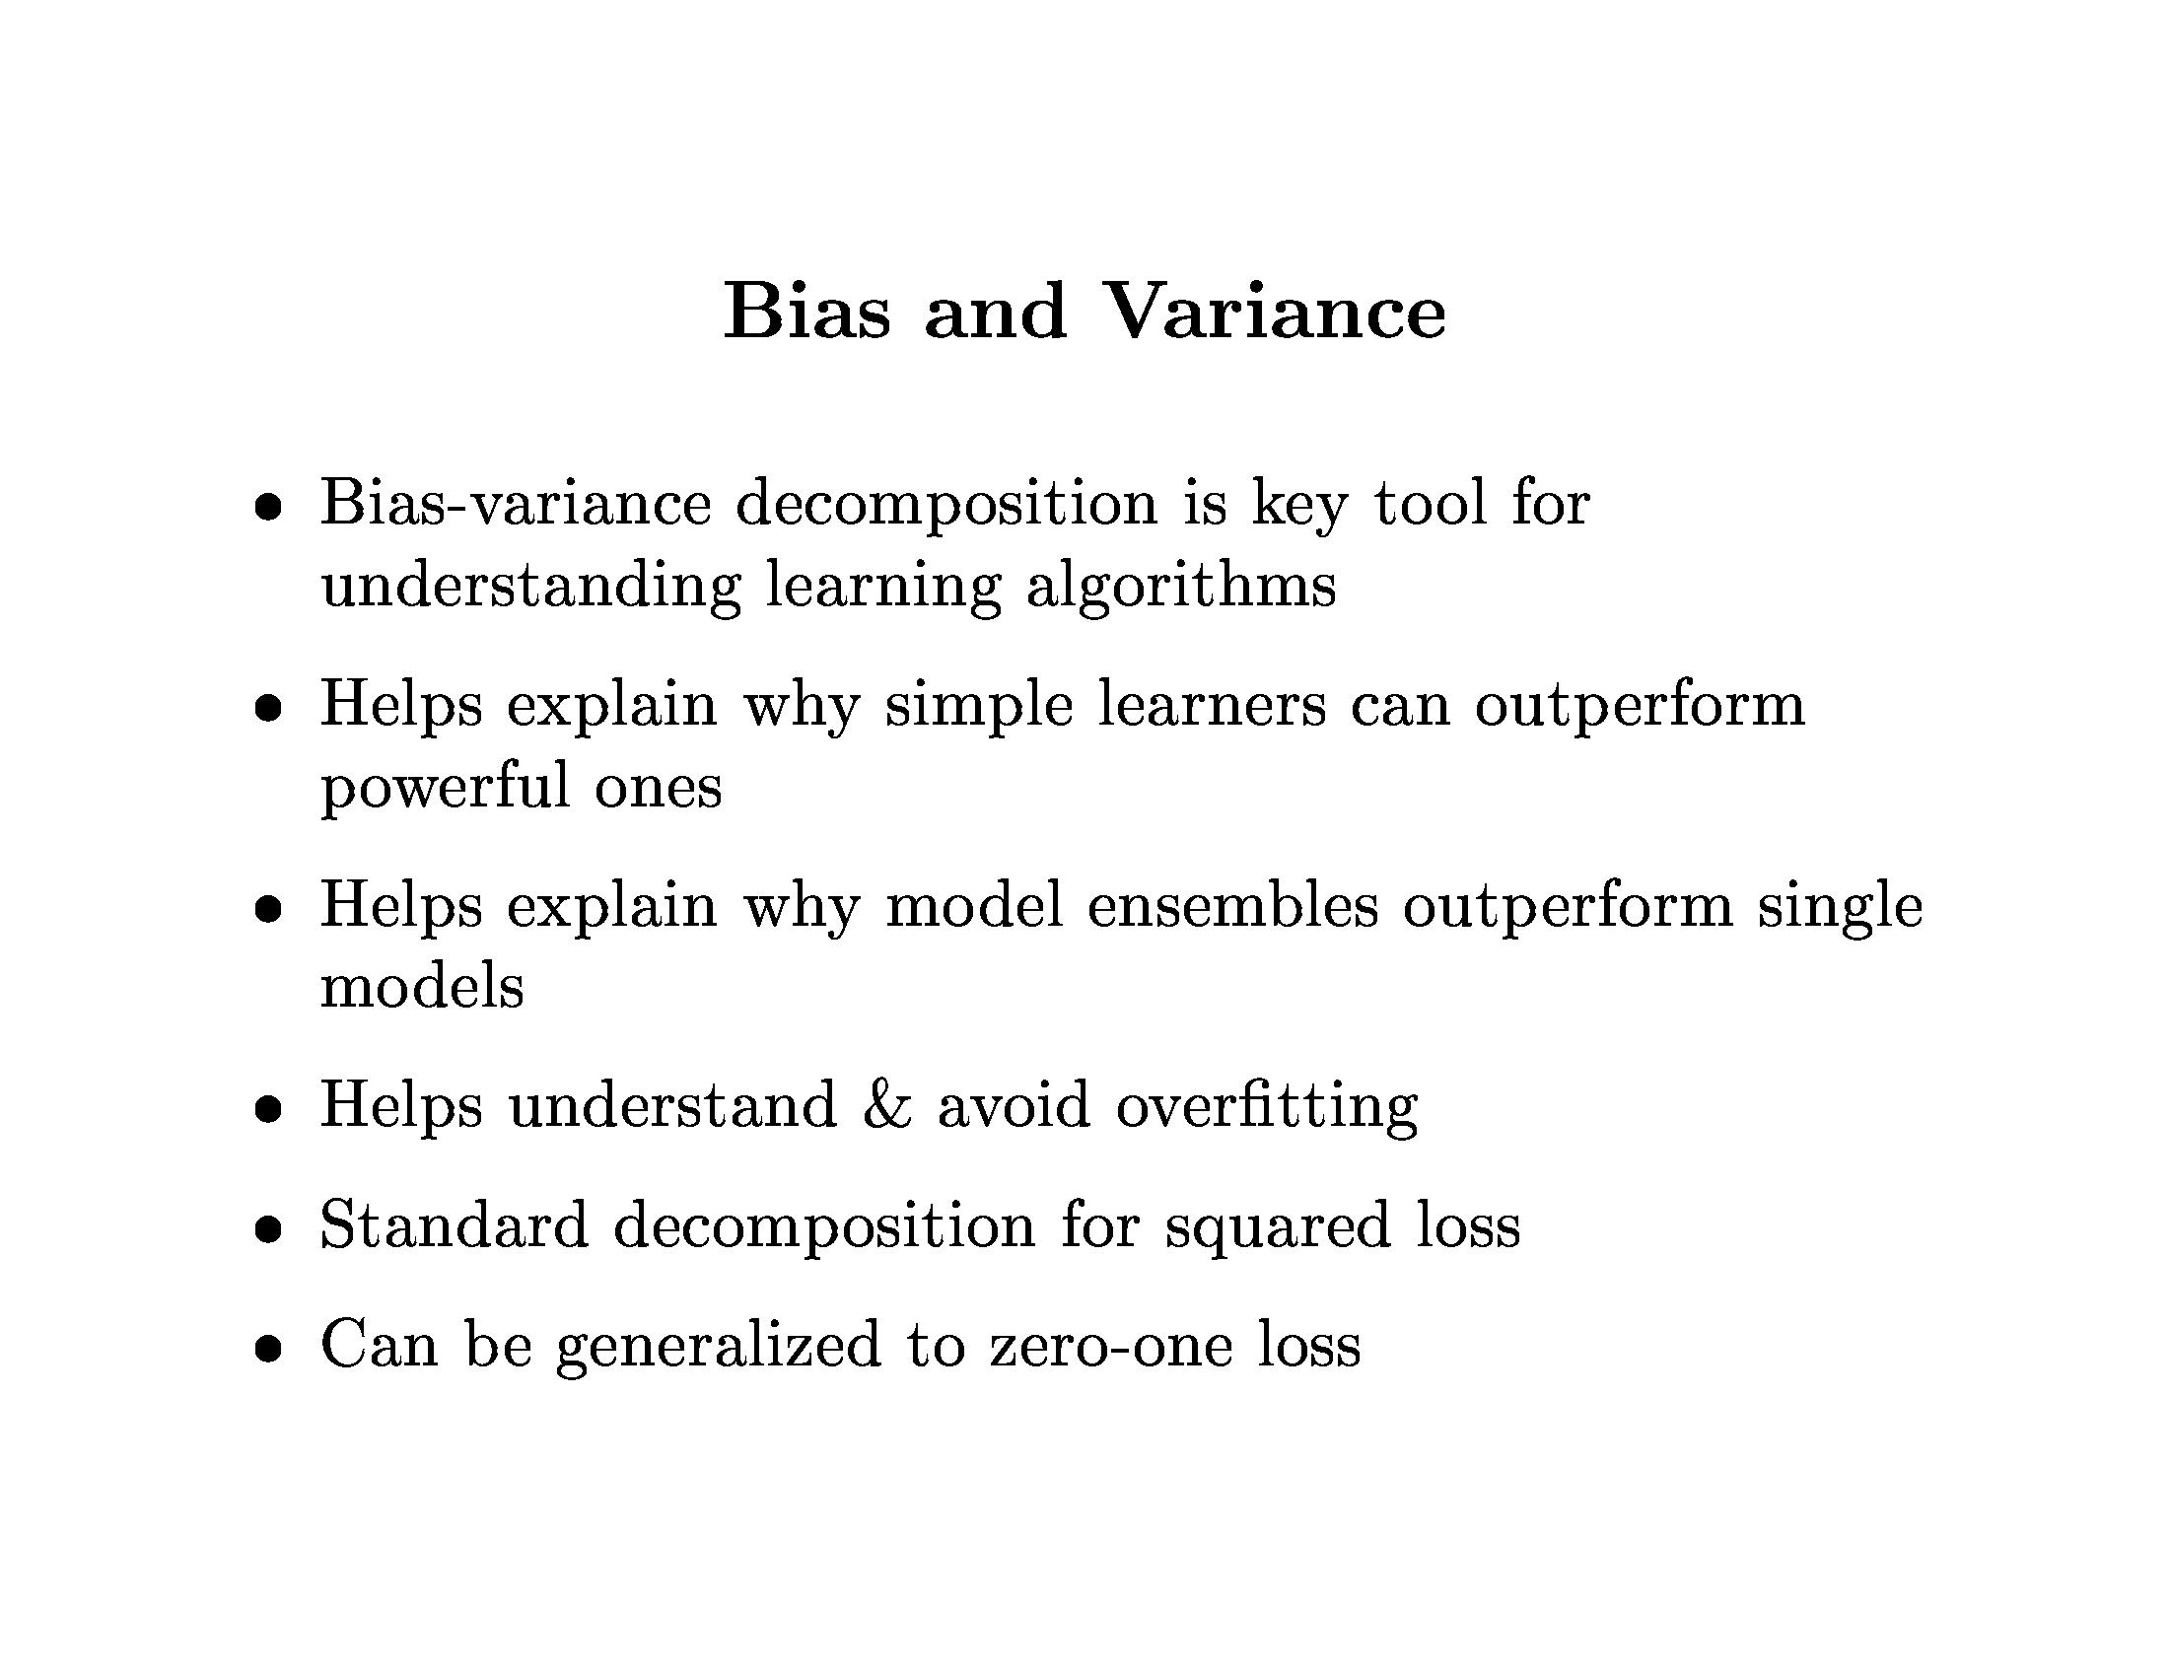
Learning Theory

Slide 7
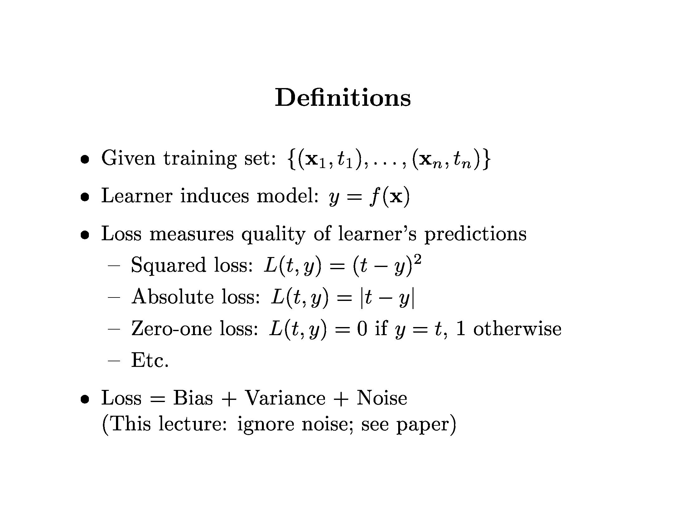
Learning Theory

Slide 8
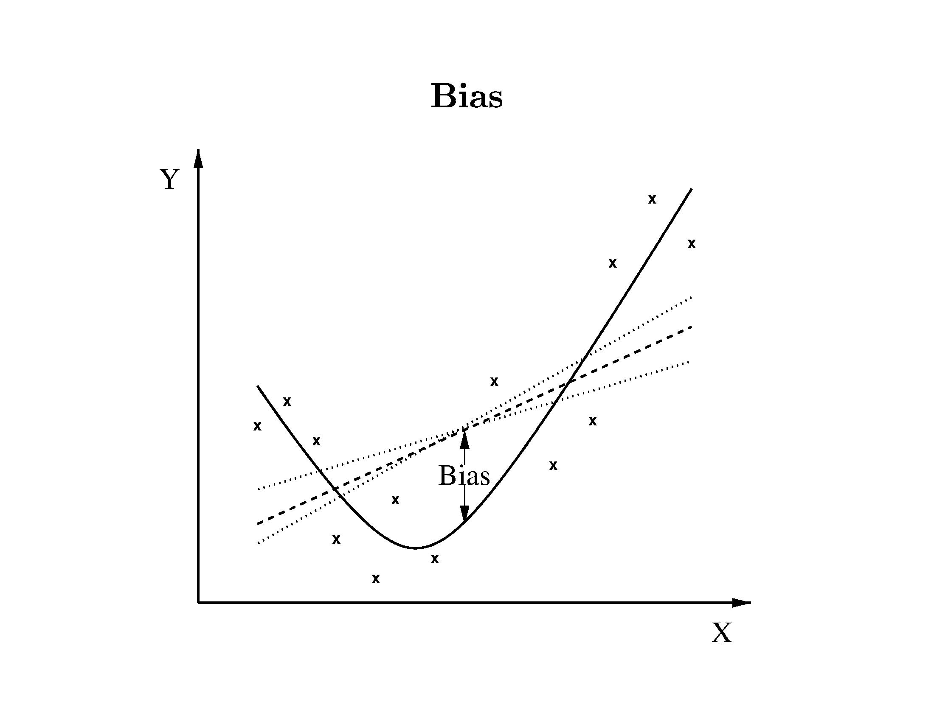
Learning Theory

Slide 9
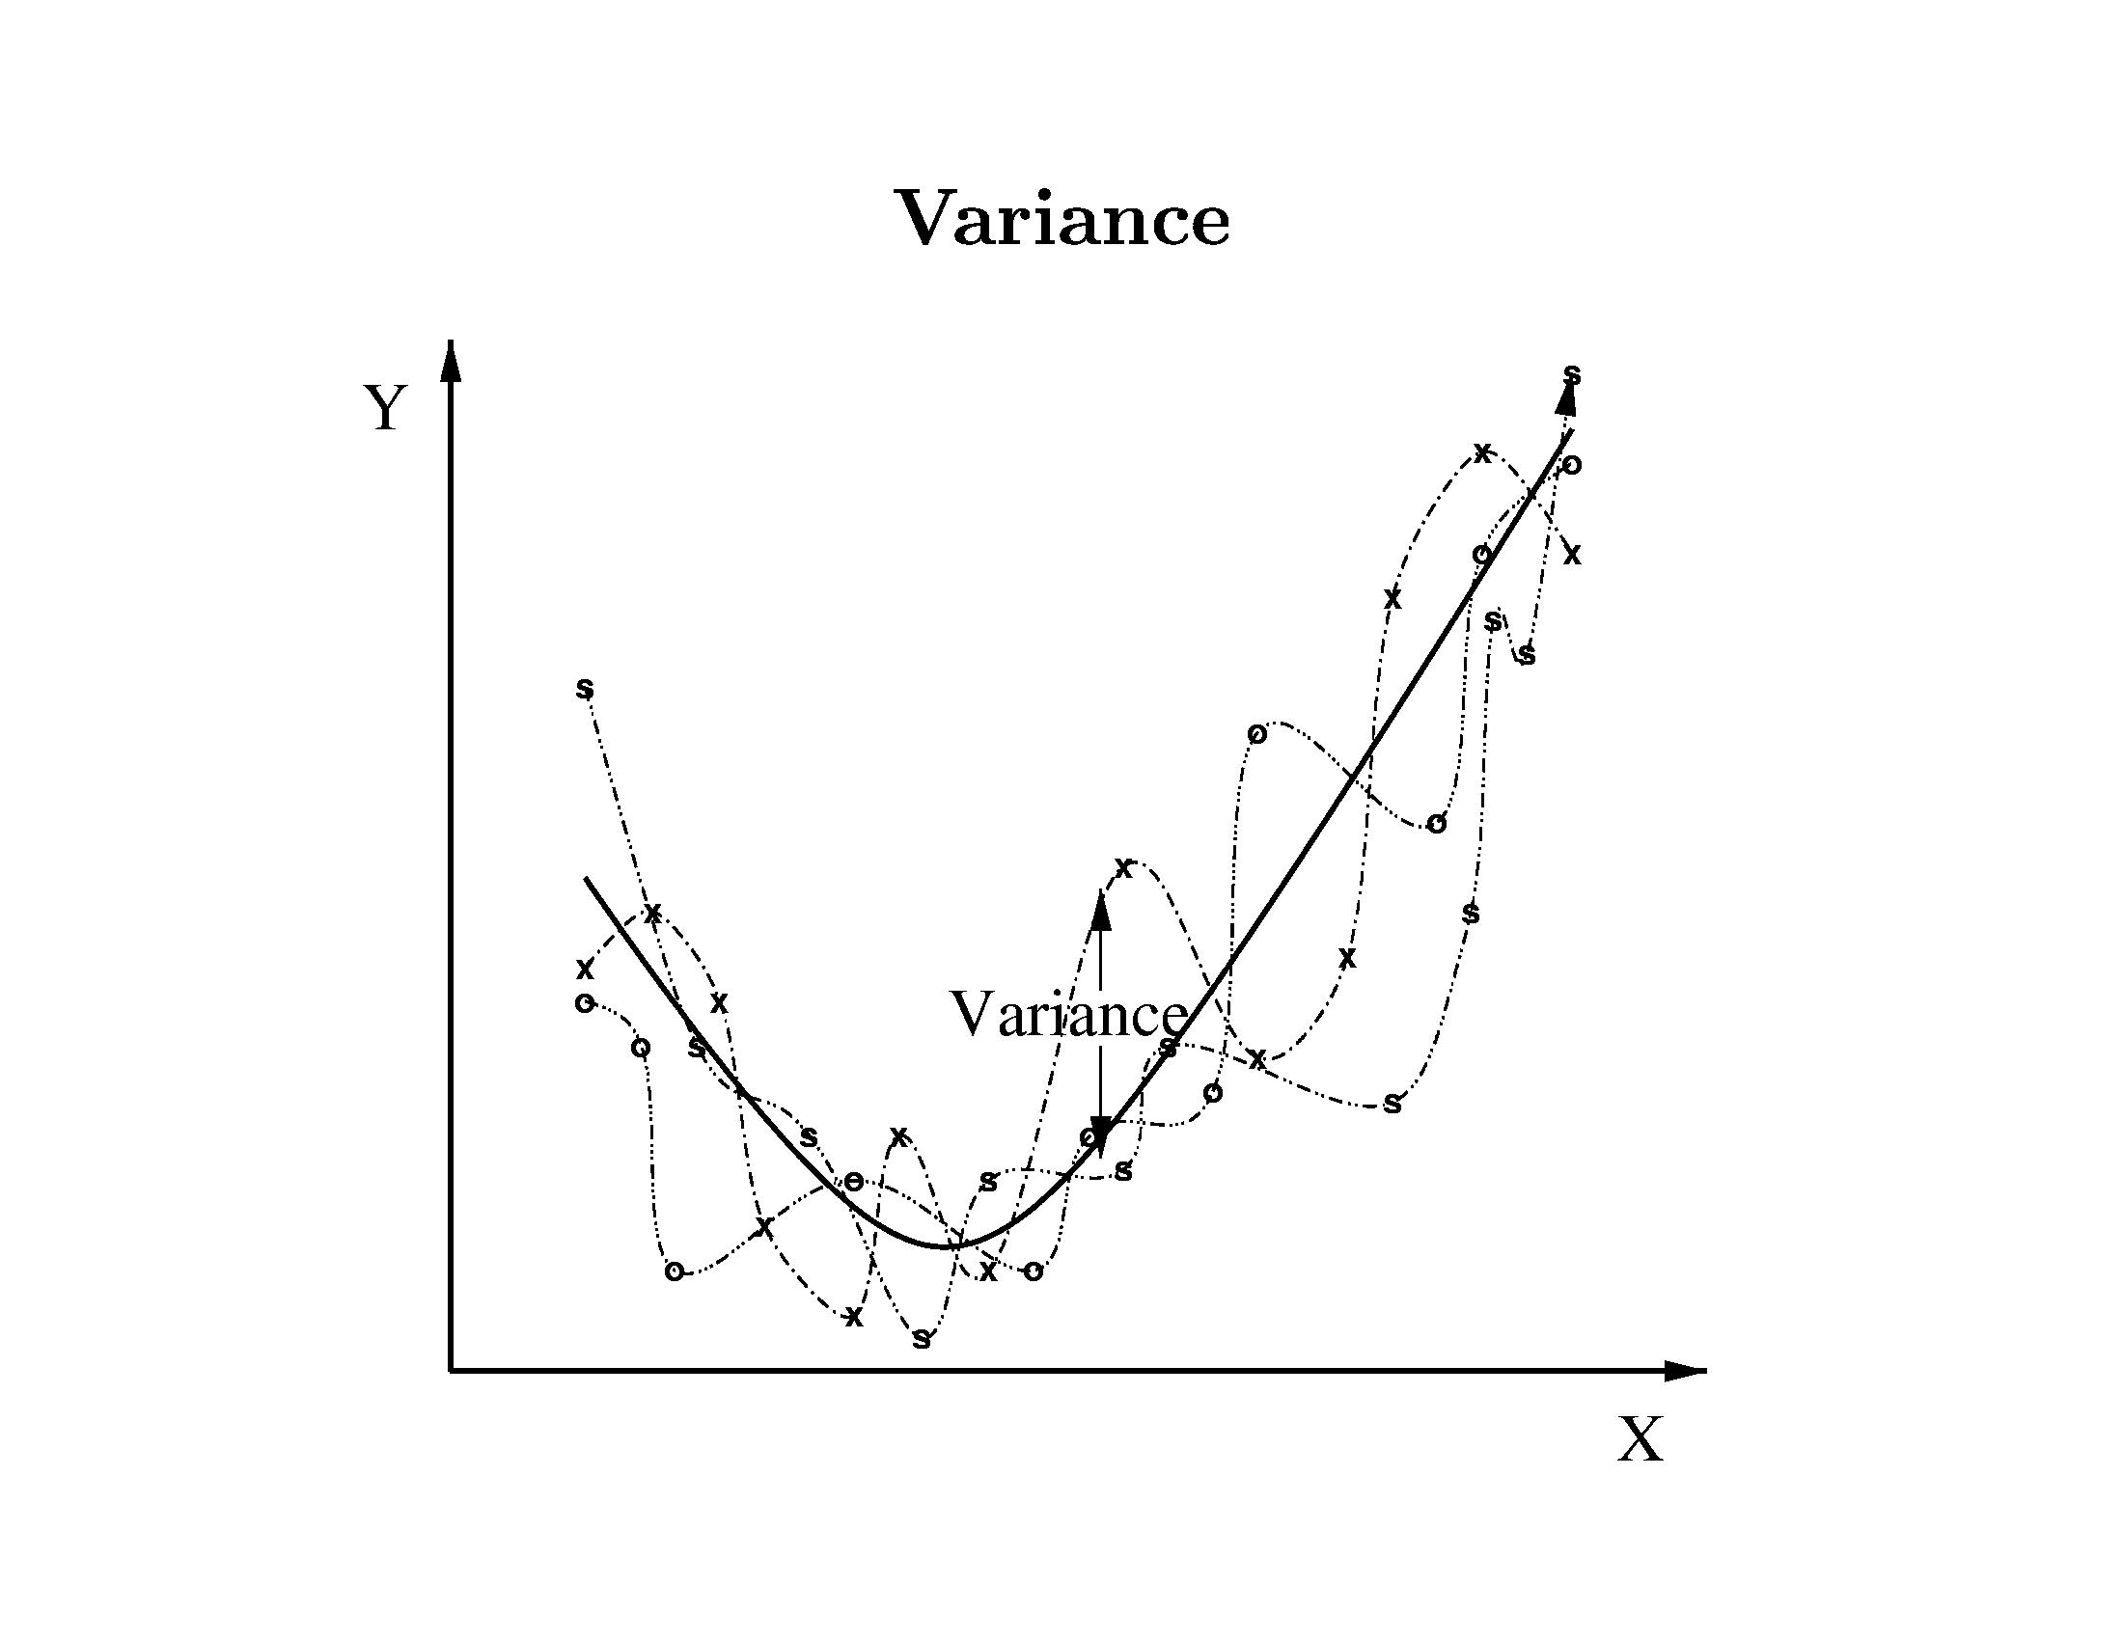
Learning Theory

Slide 10
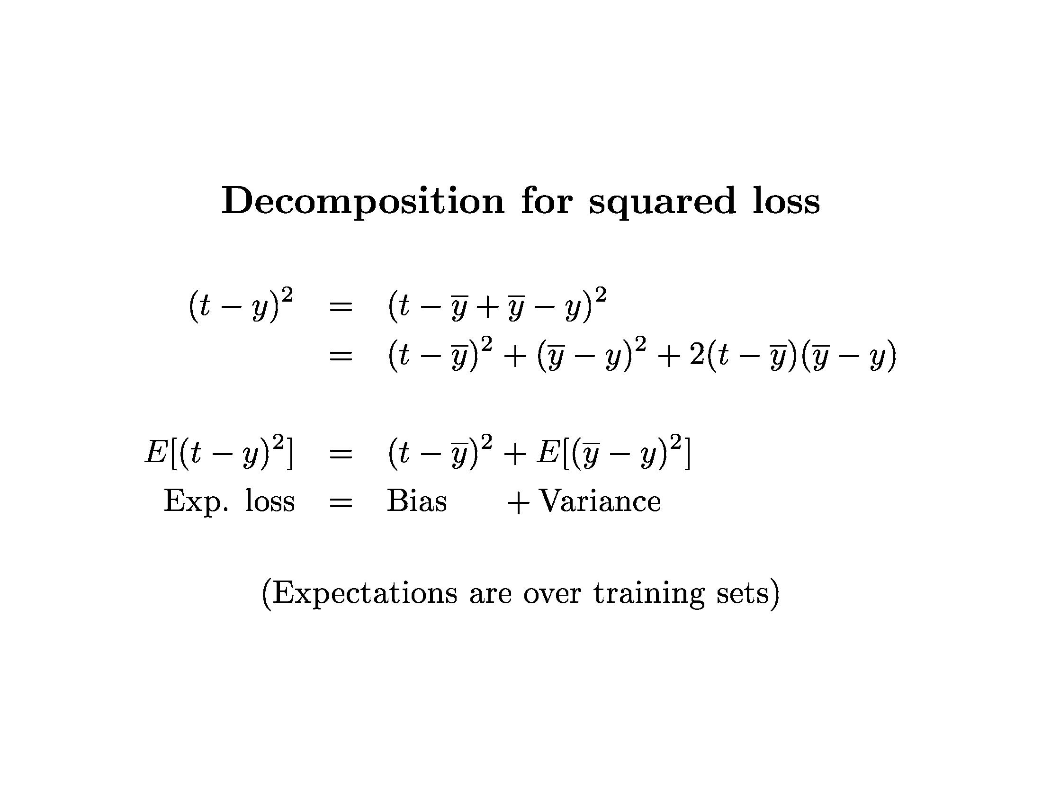
Learning Theory

Slide 11
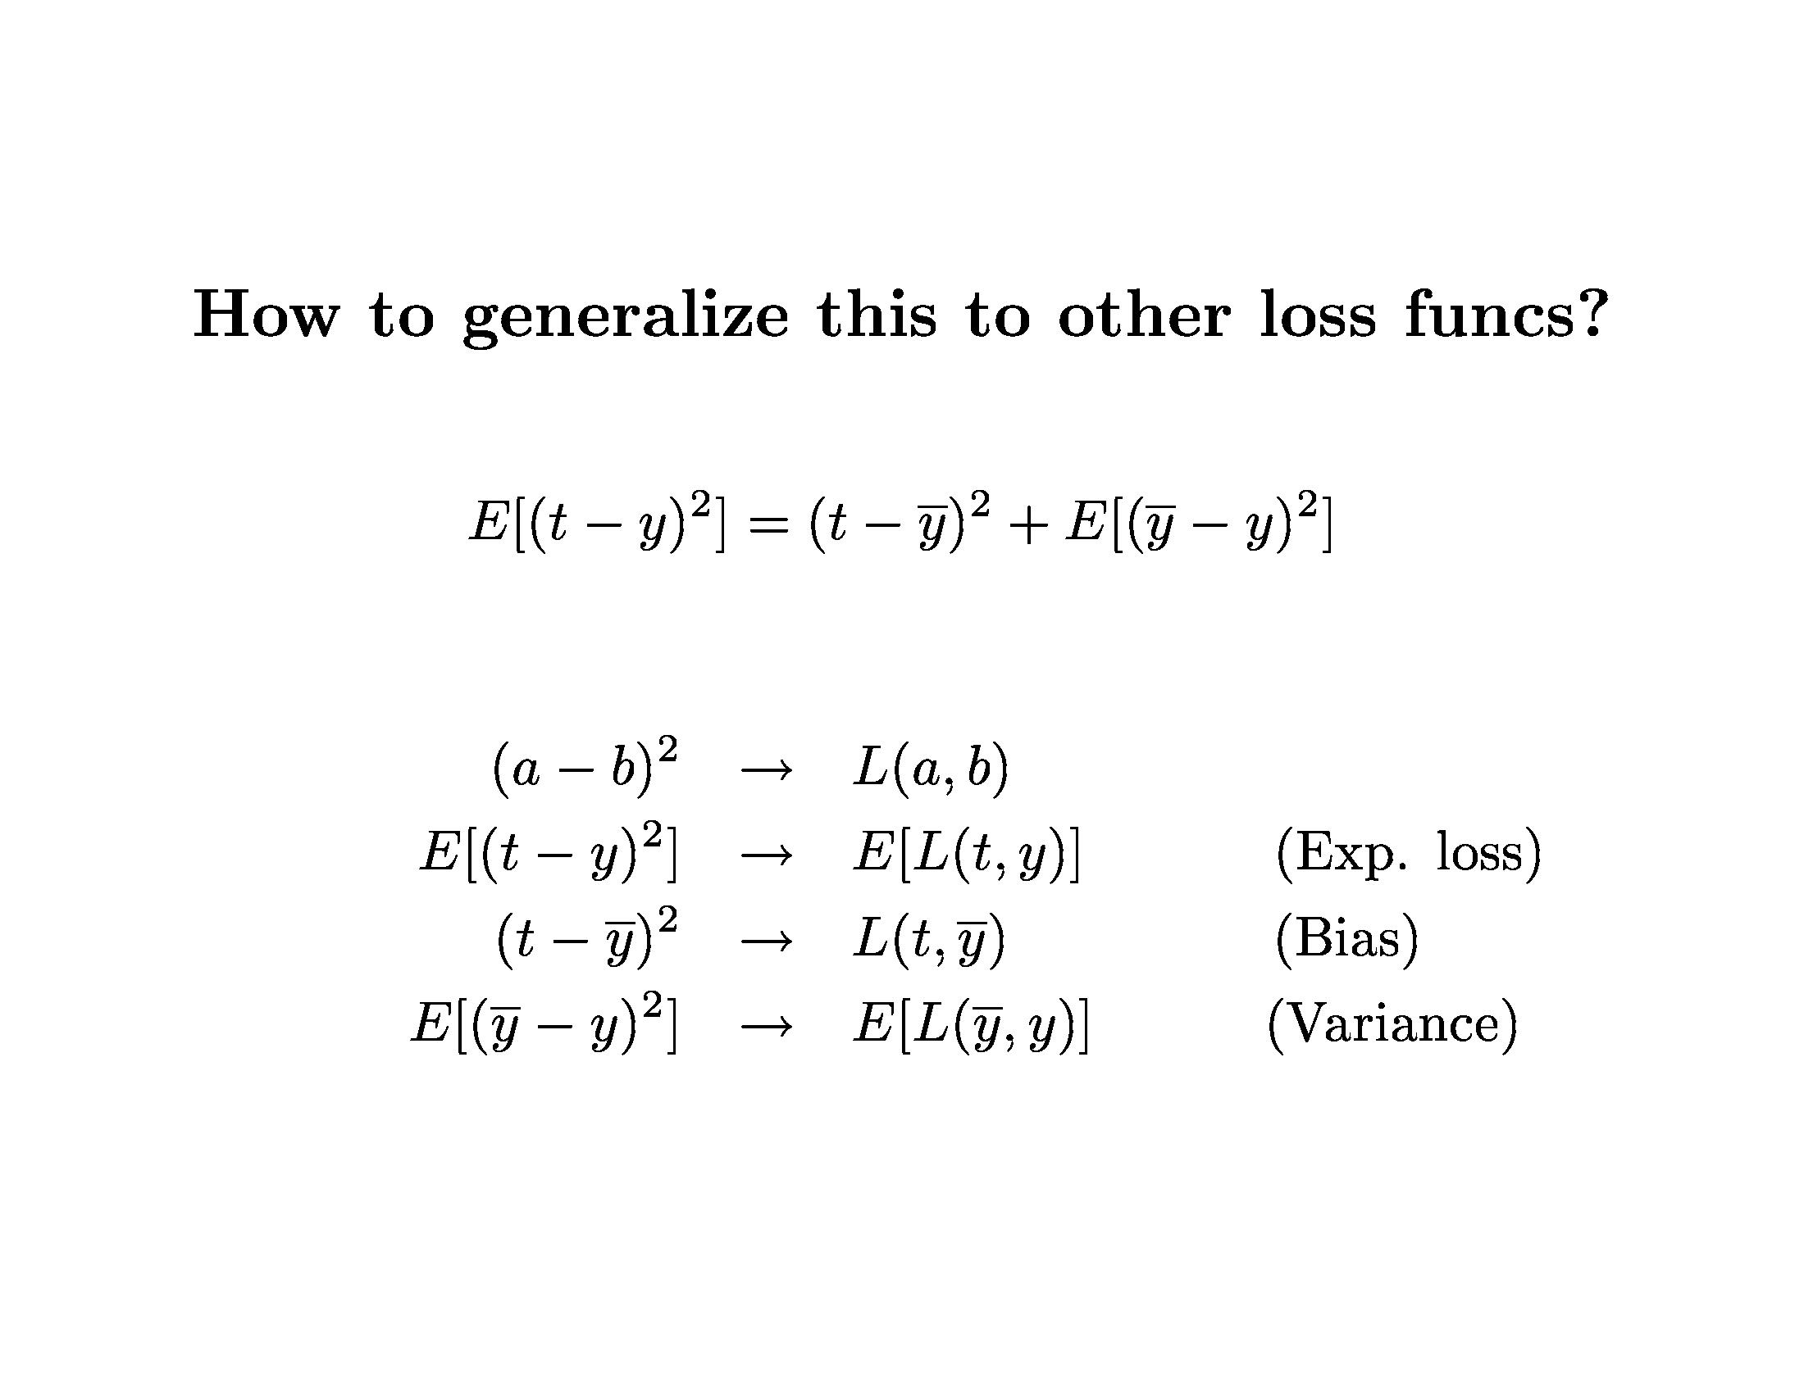
Learning Theory

Slide 12
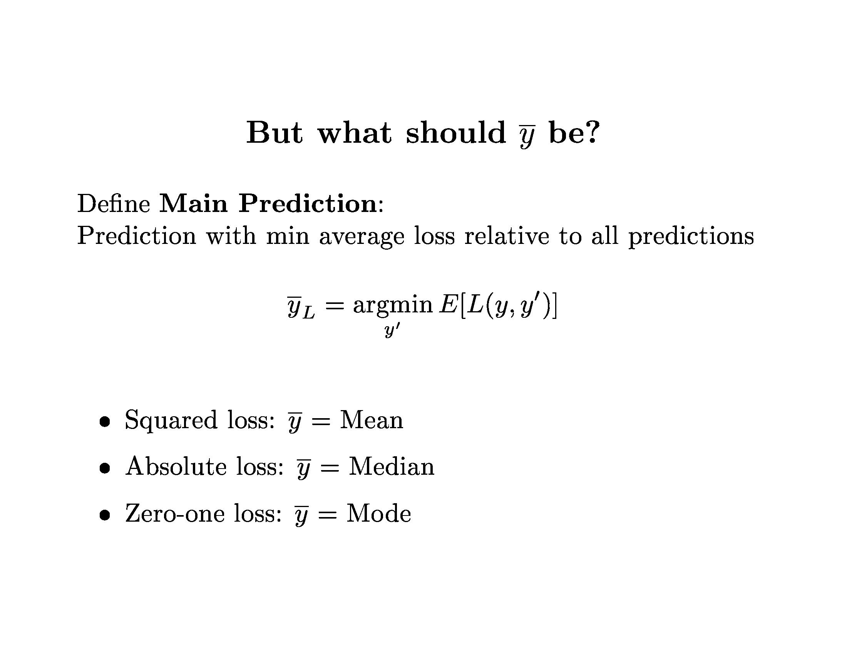
Learning Theory

Slide 13
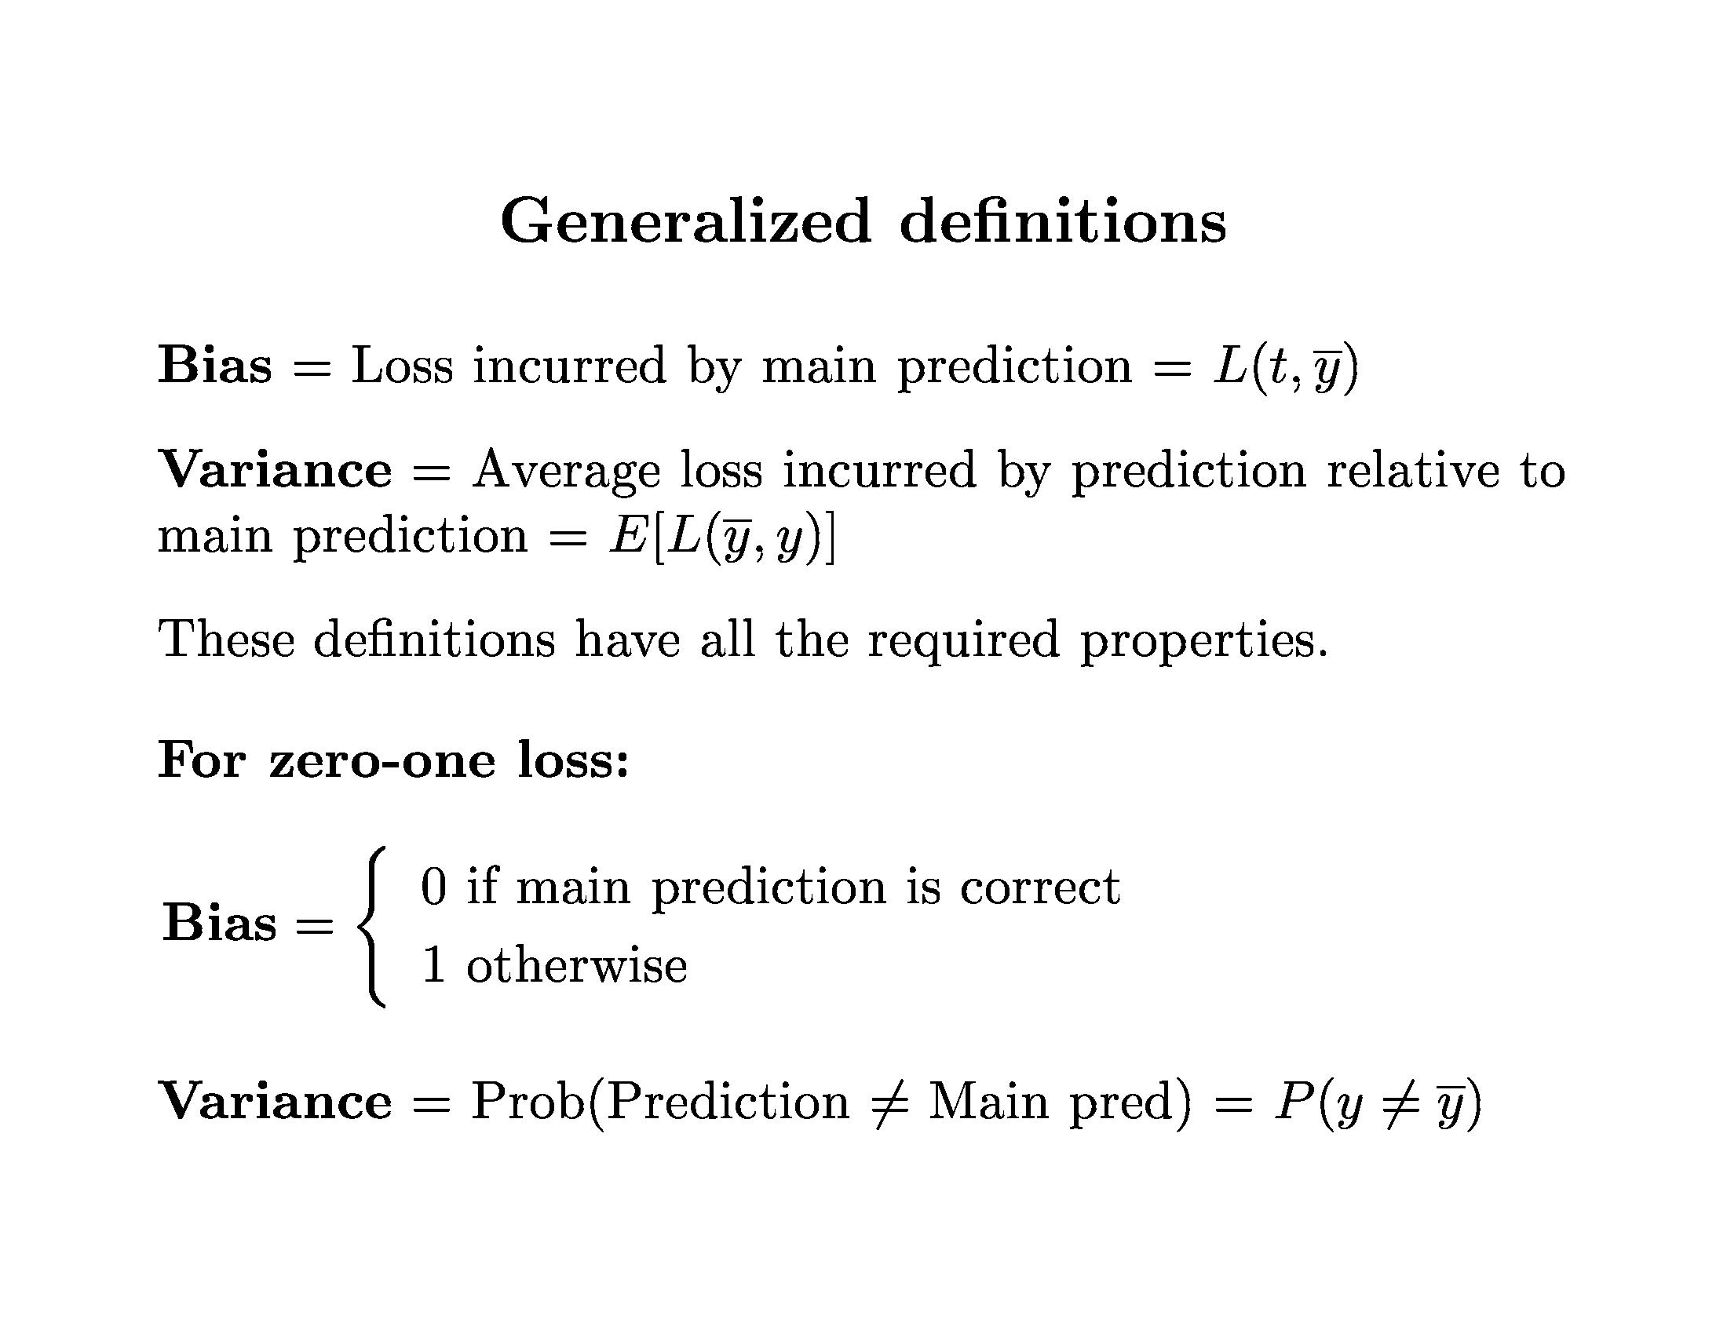
Learning Theory

Slide 14
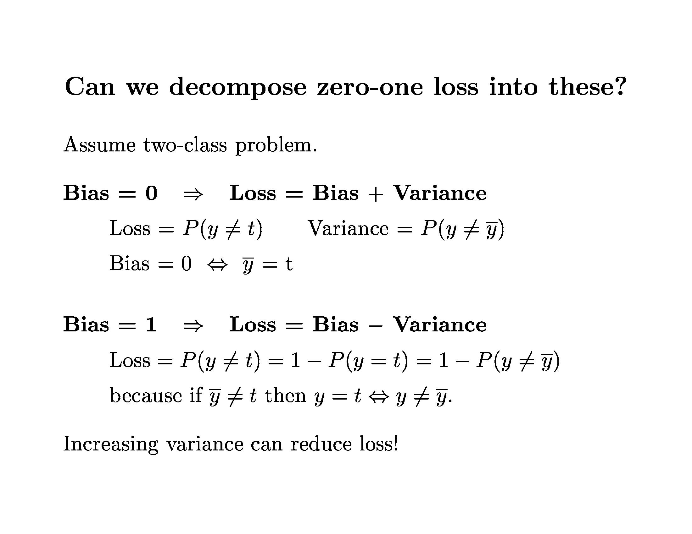
Learning Theory

Slide 15
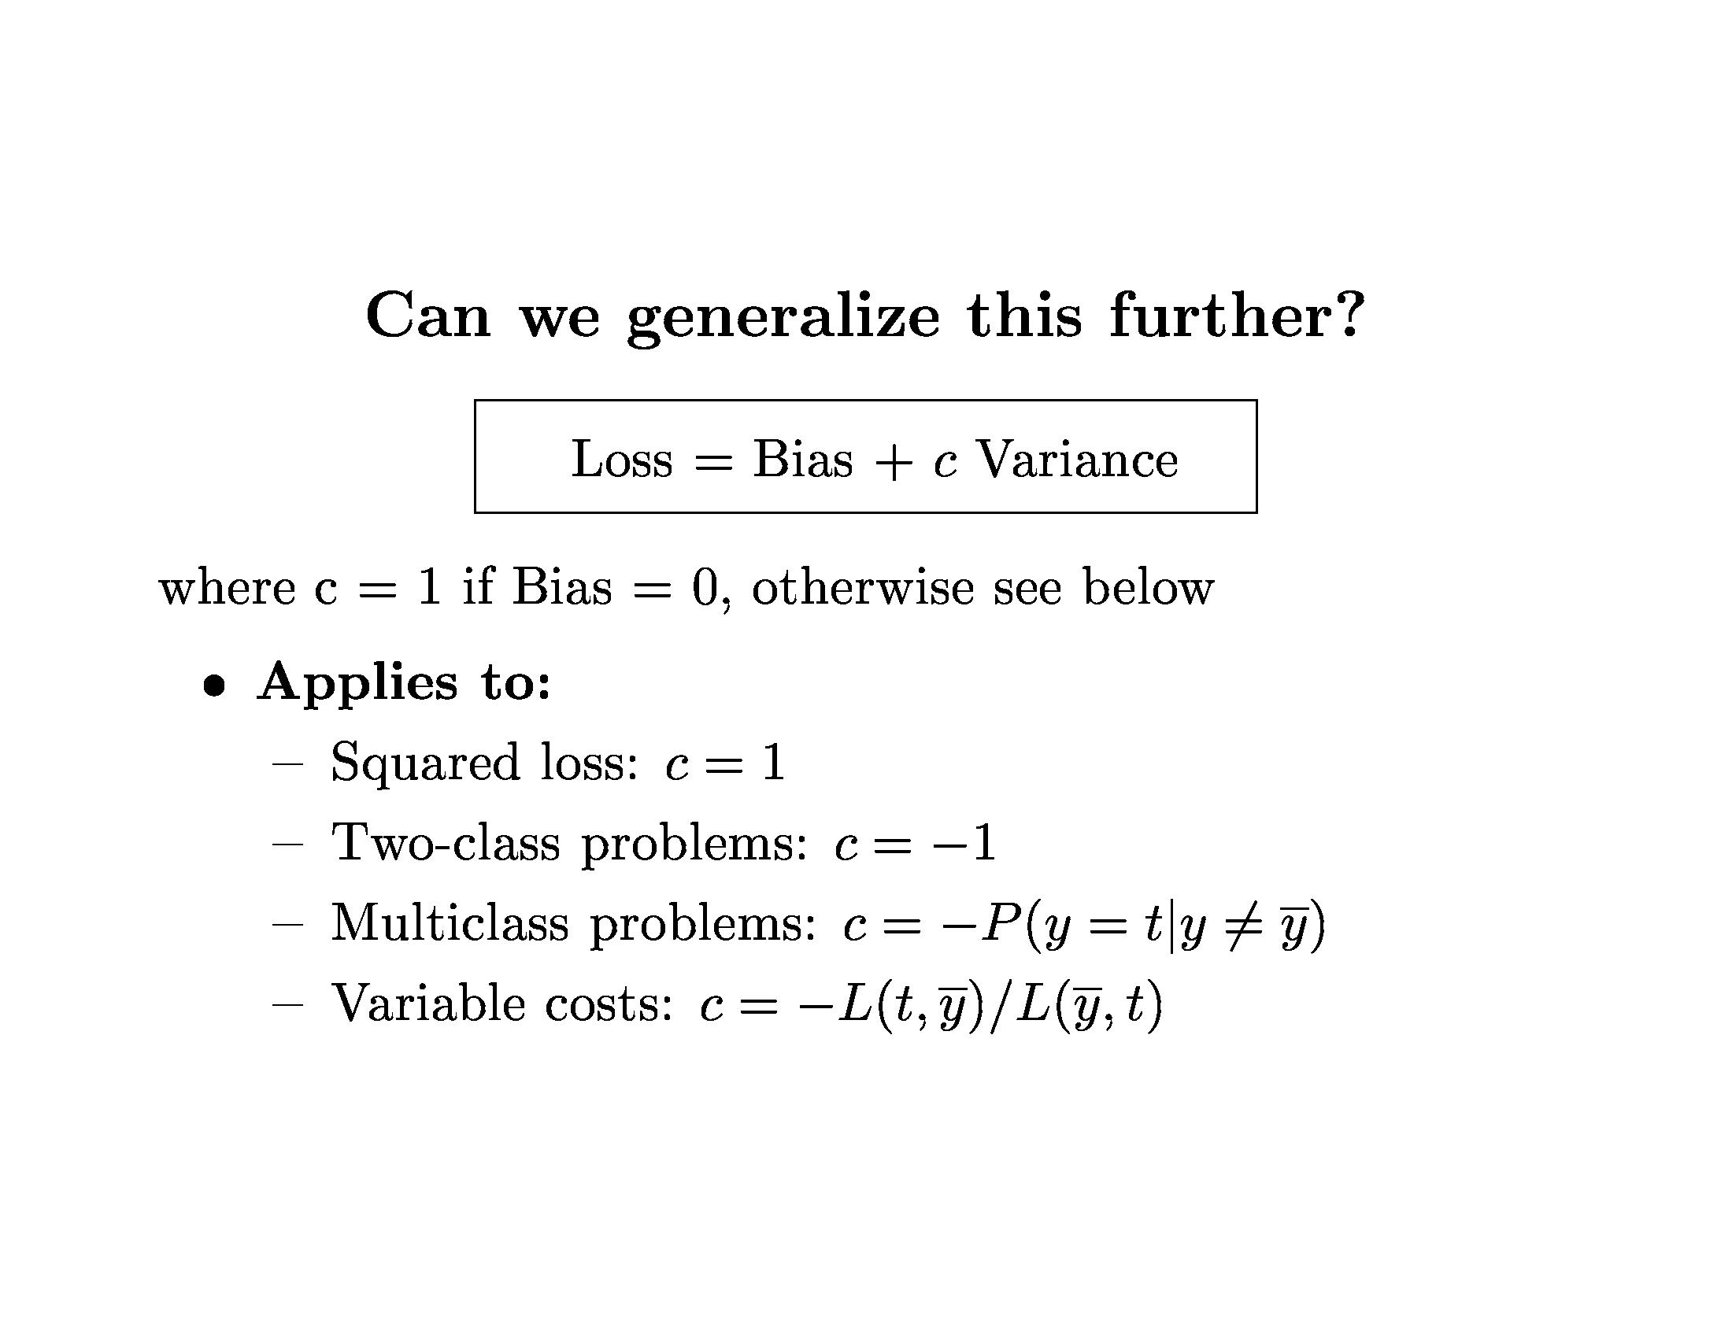
Learning Theory

Slide 16
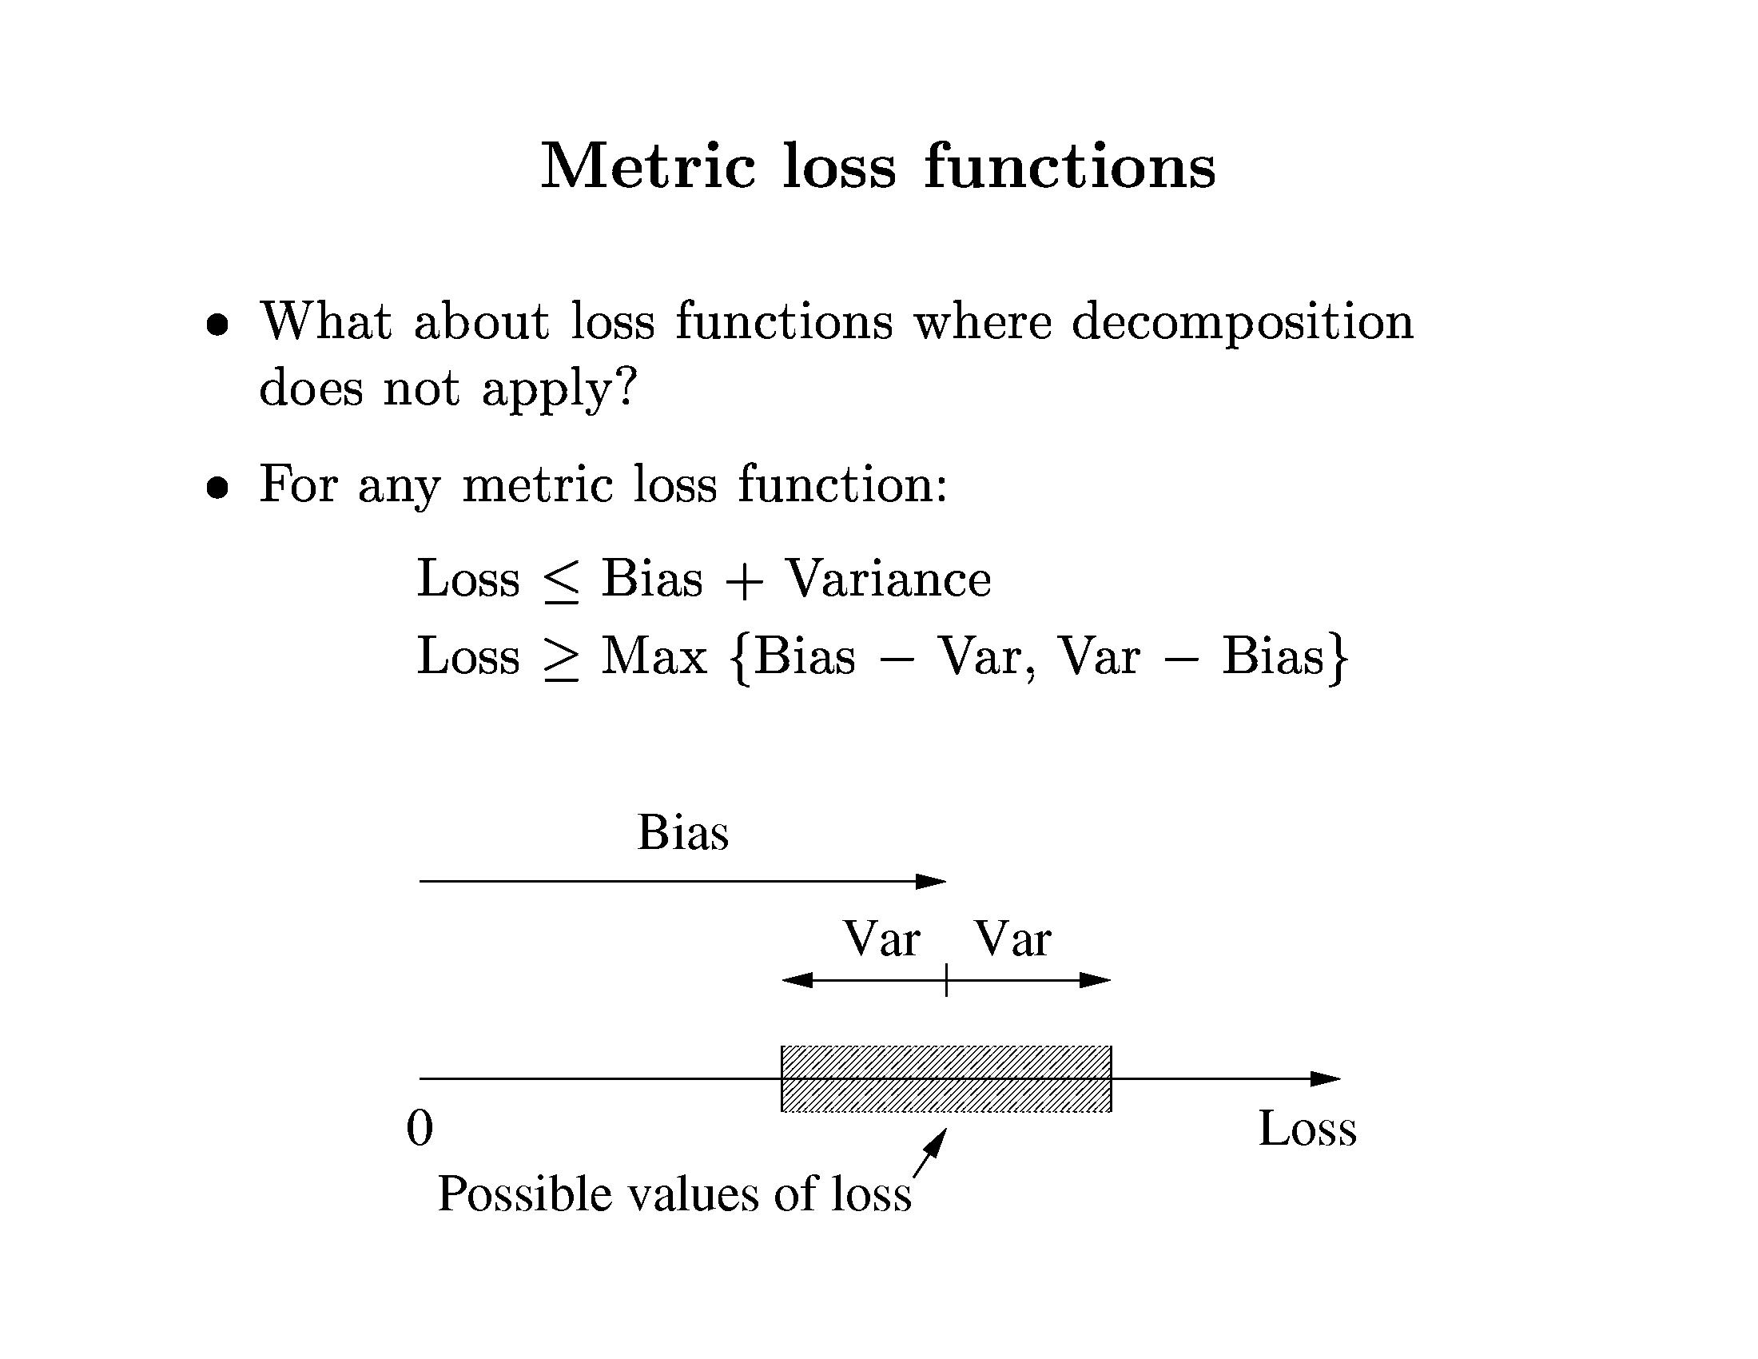
Learning Theory

Slide 17
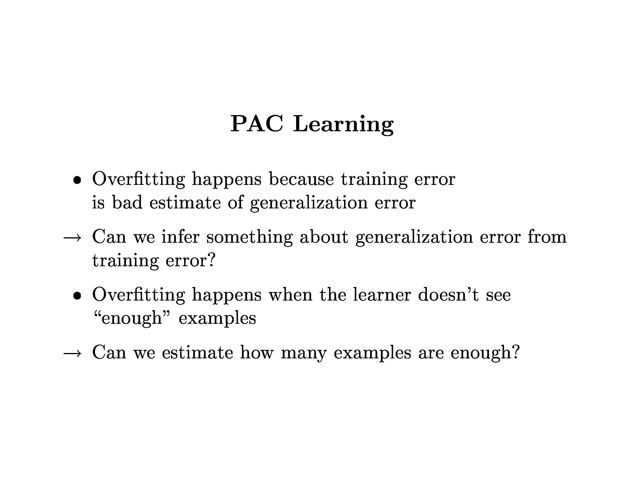
Learning Theory

Slide 18
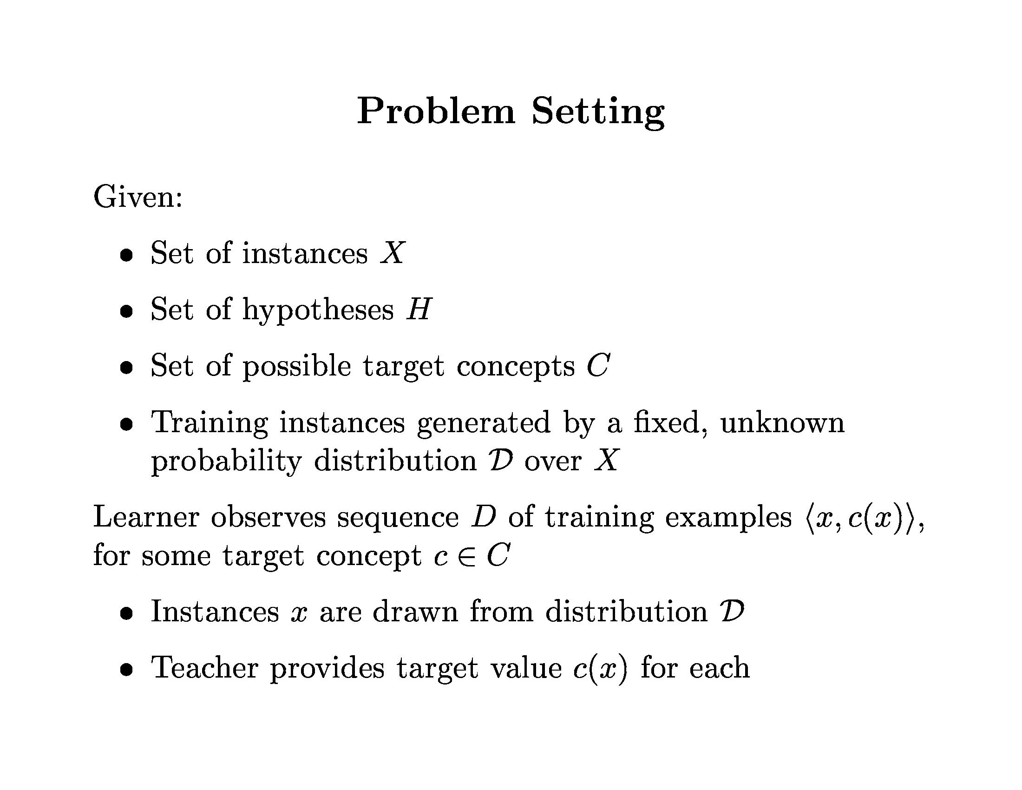
Learning Theory

Slide 19
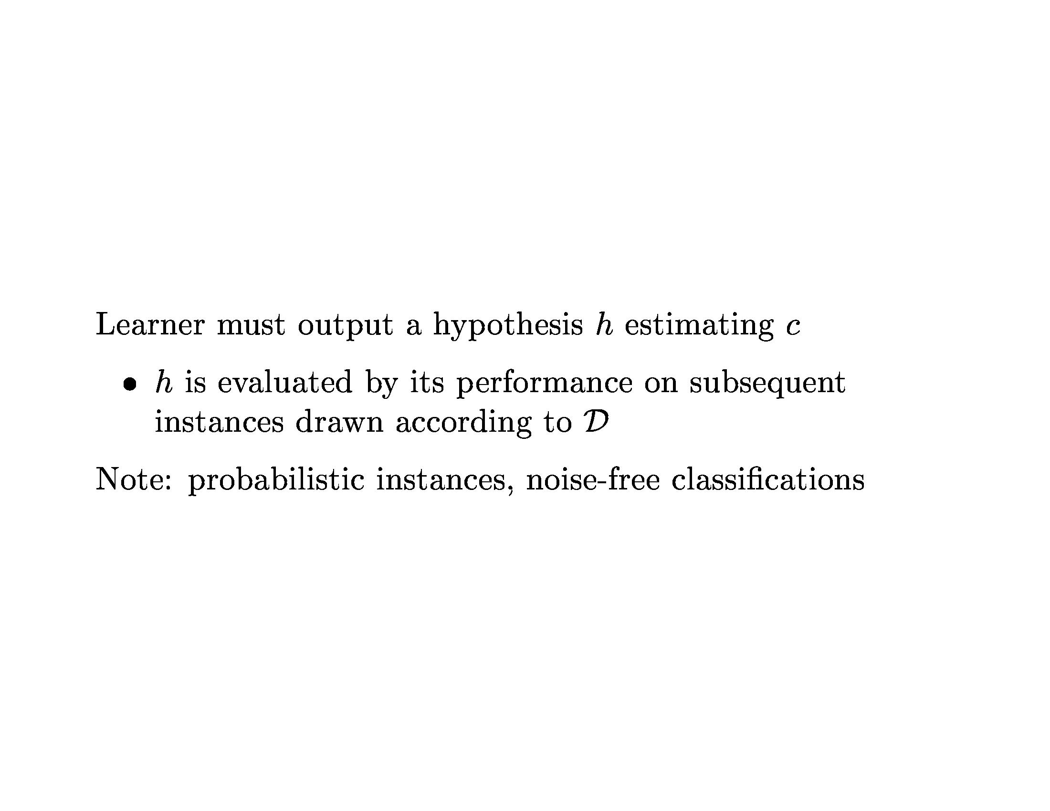
Learning Theory

Slide 20
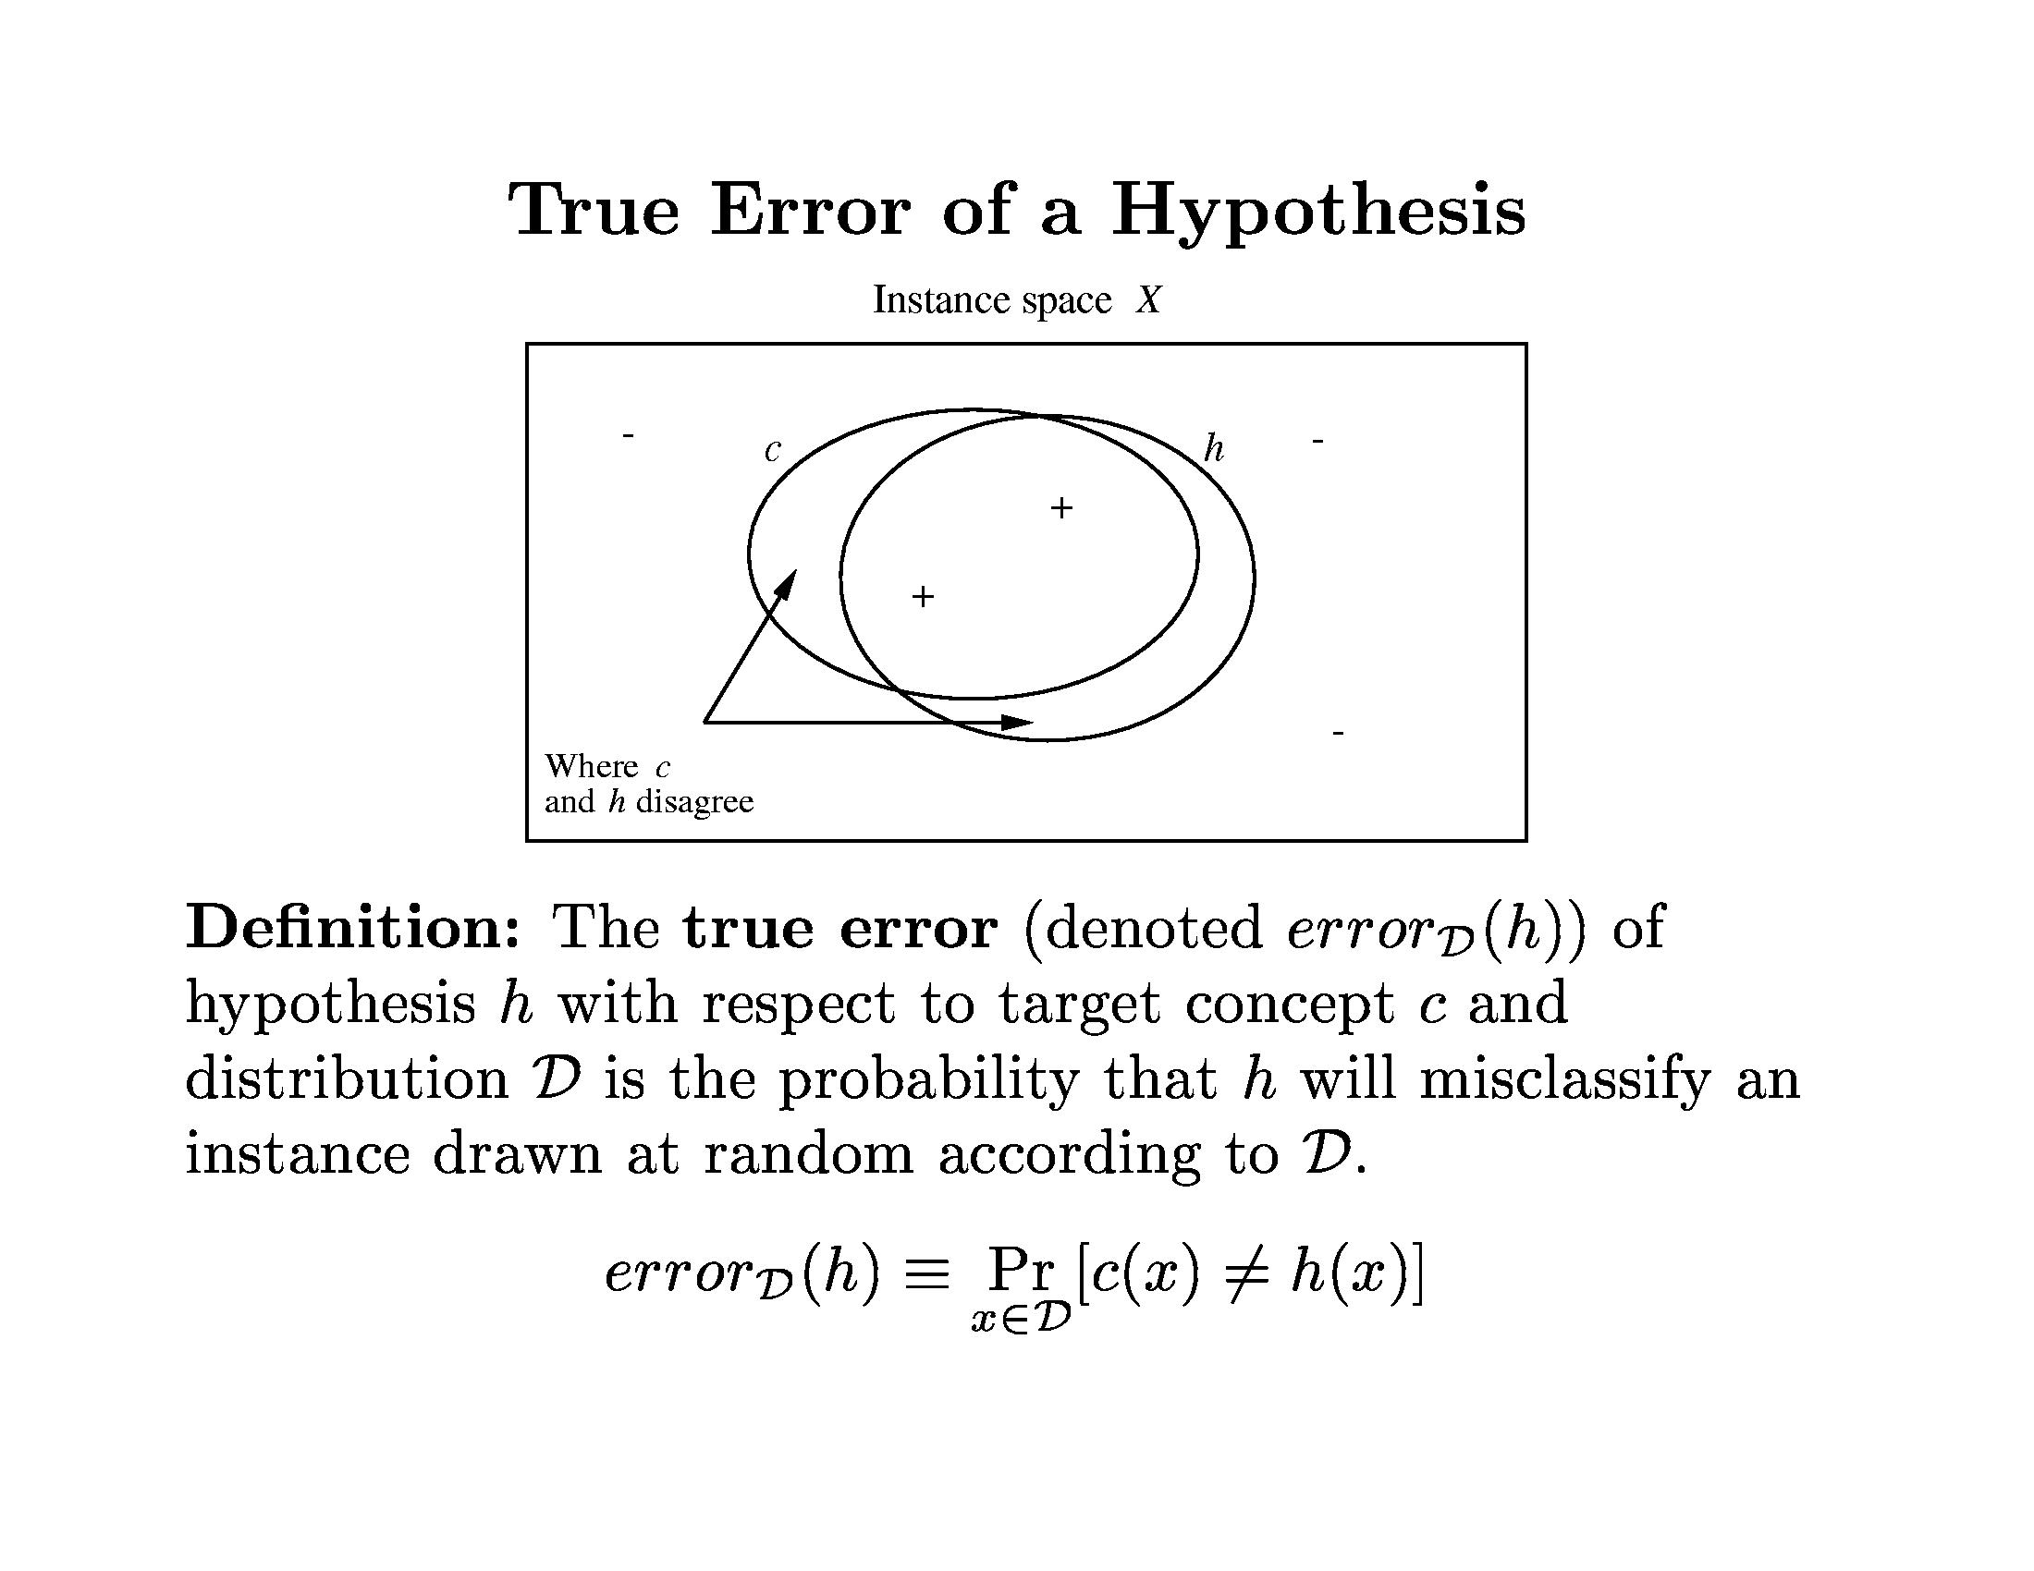
Learning Theory

Slide 21
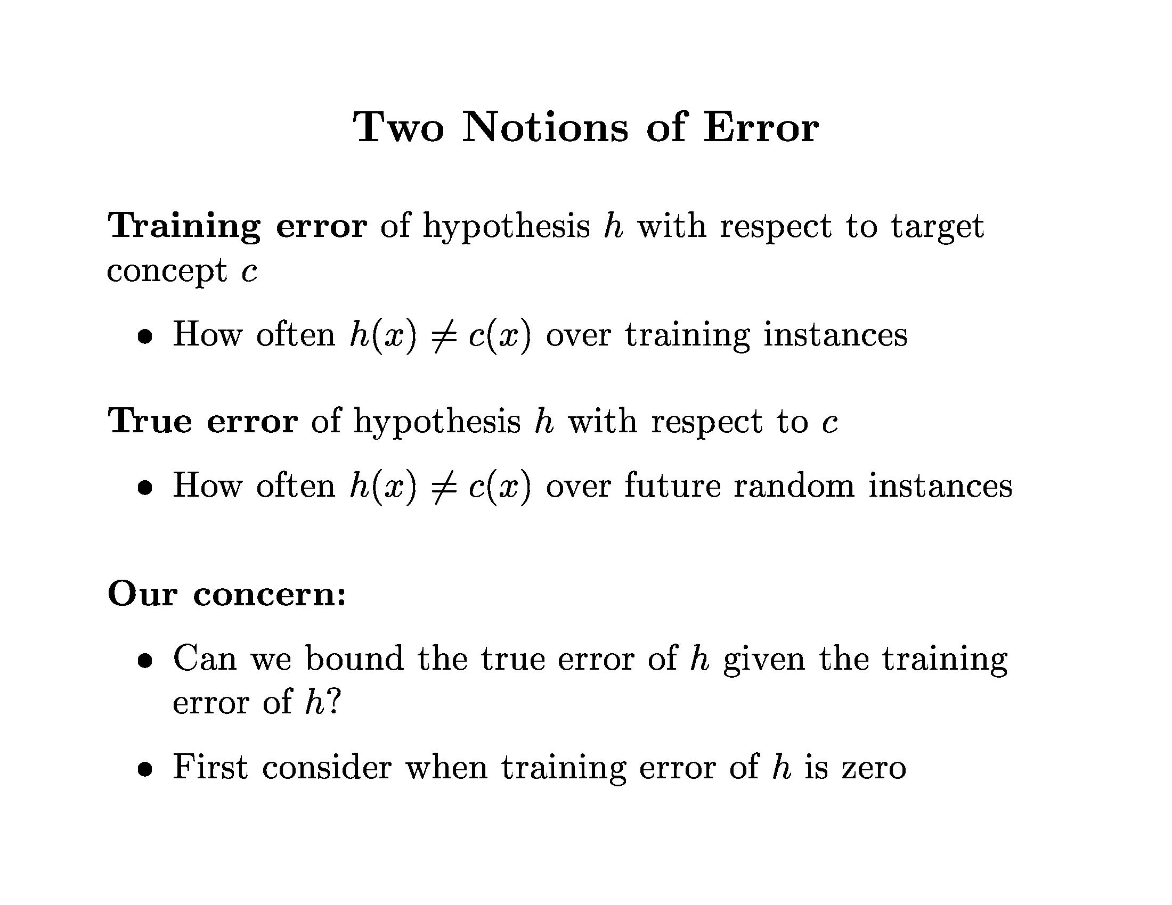
Learning Theory

Slide 22
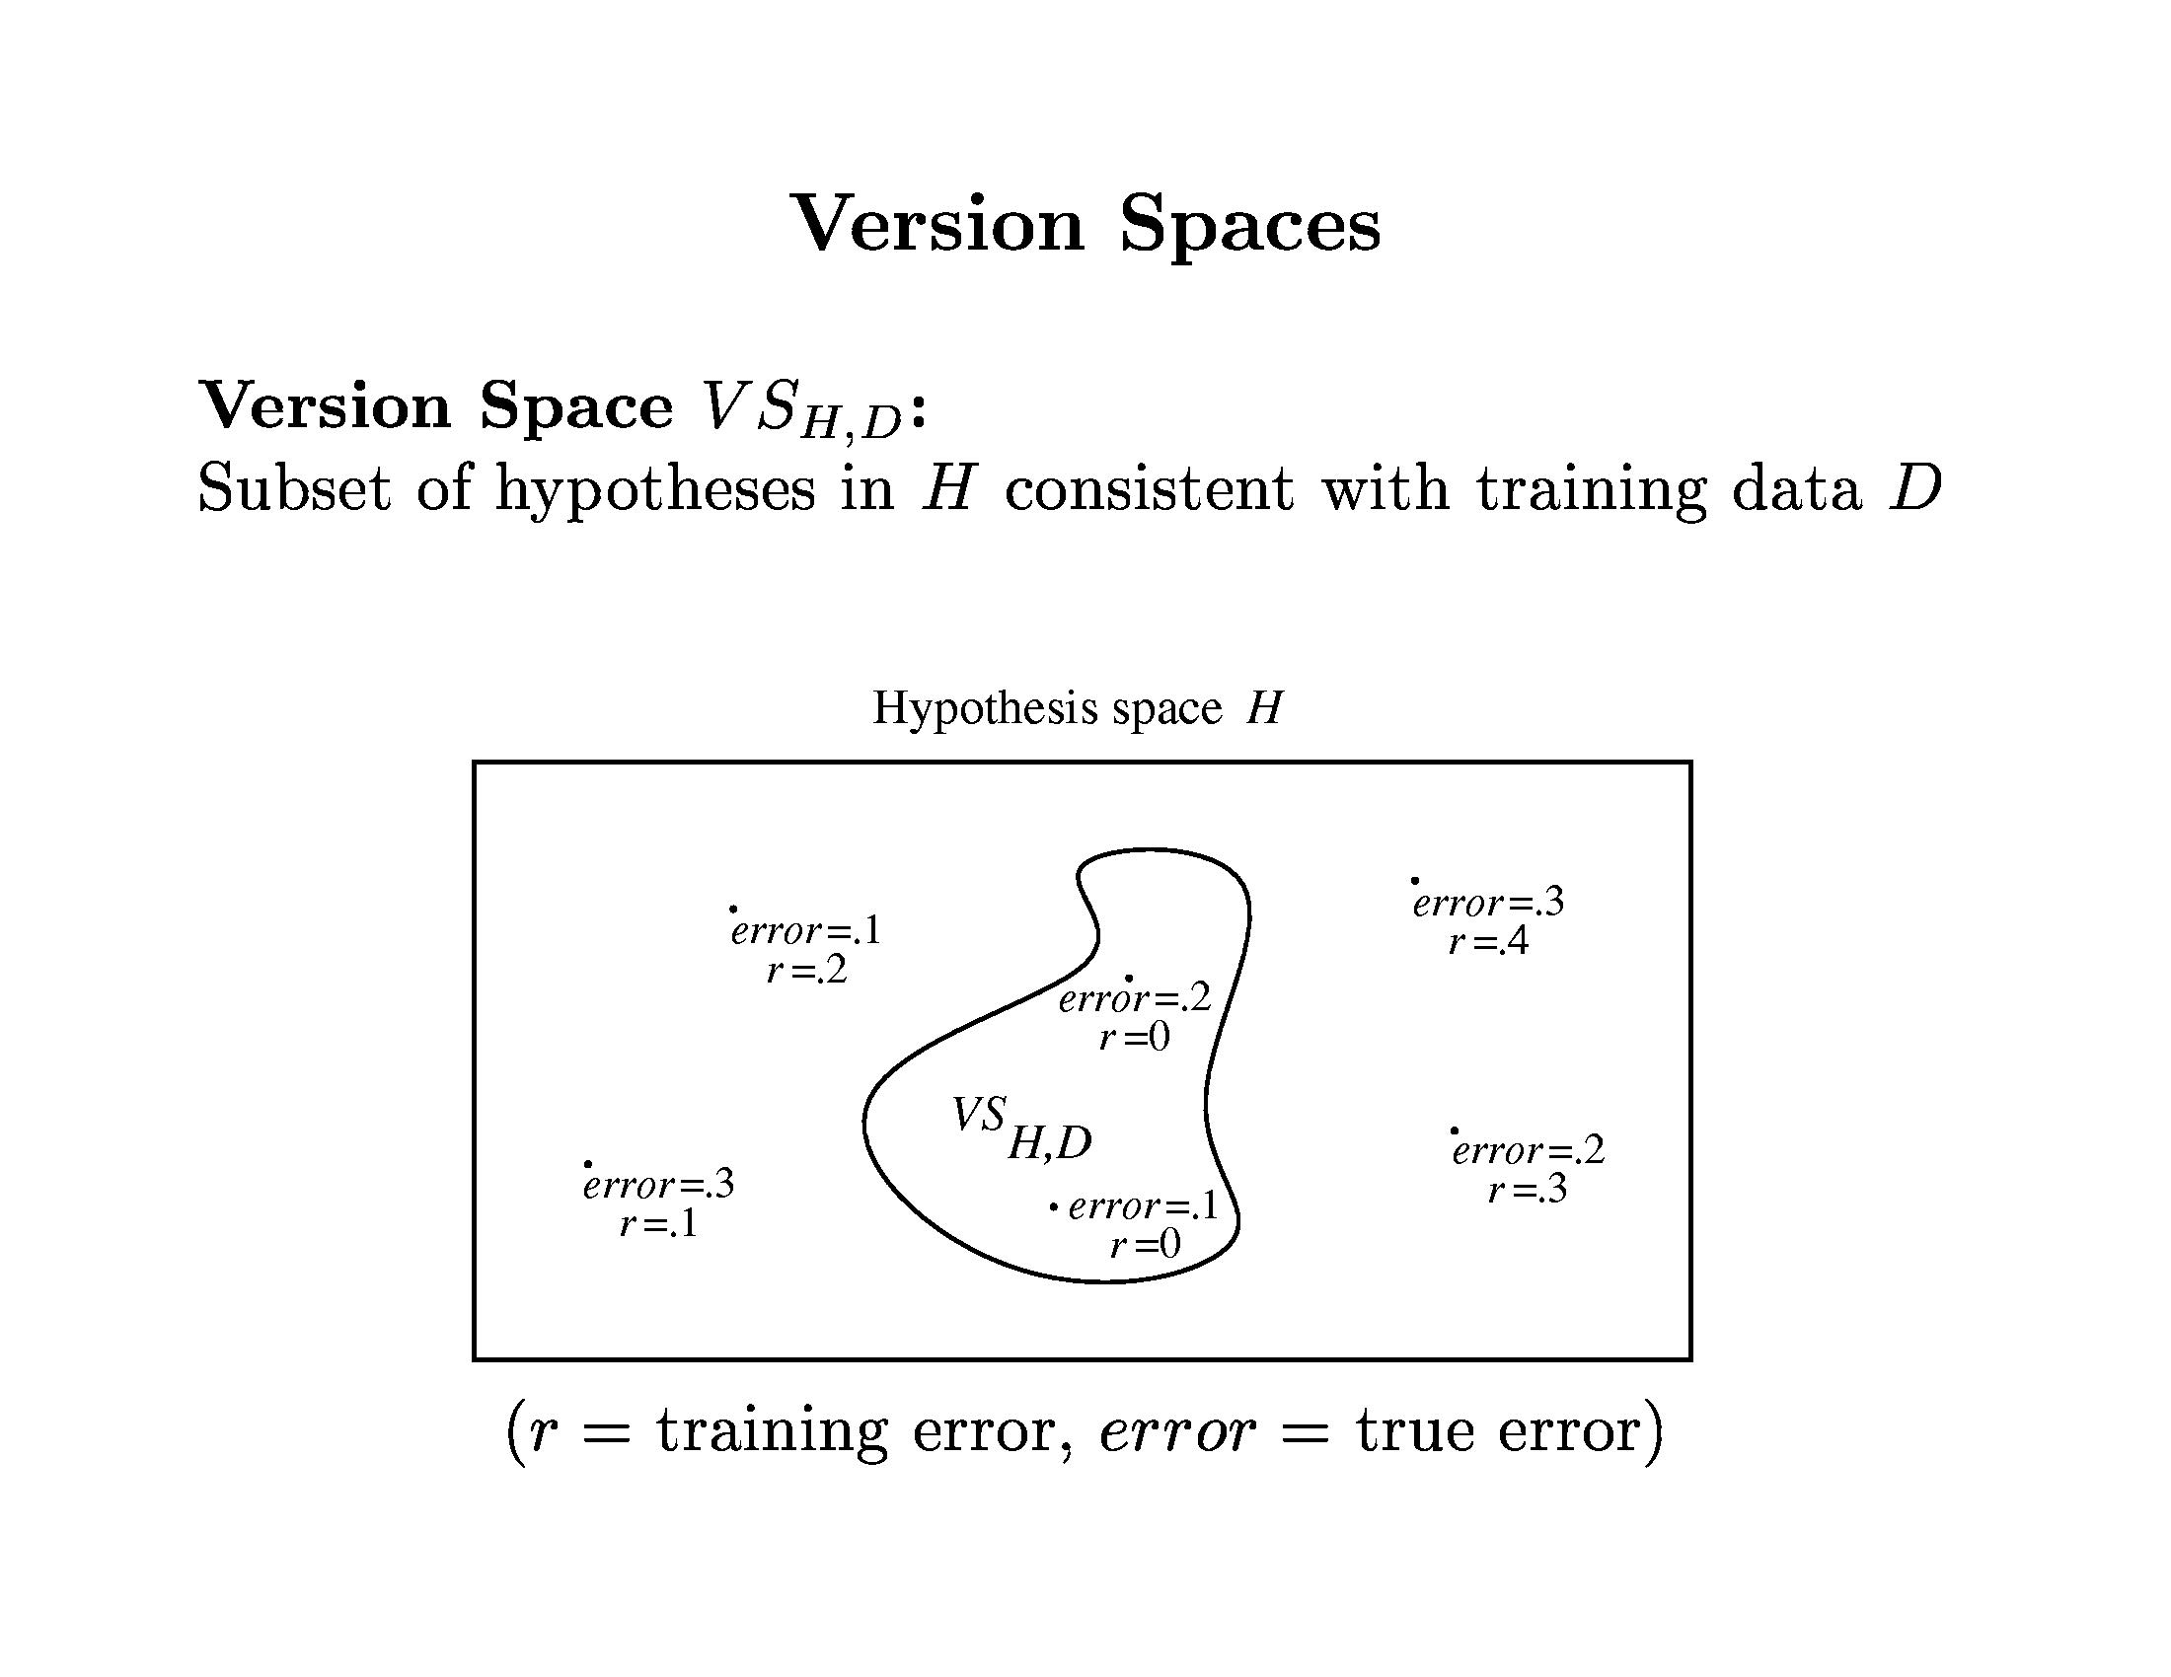
Learning Theory

Slide 23
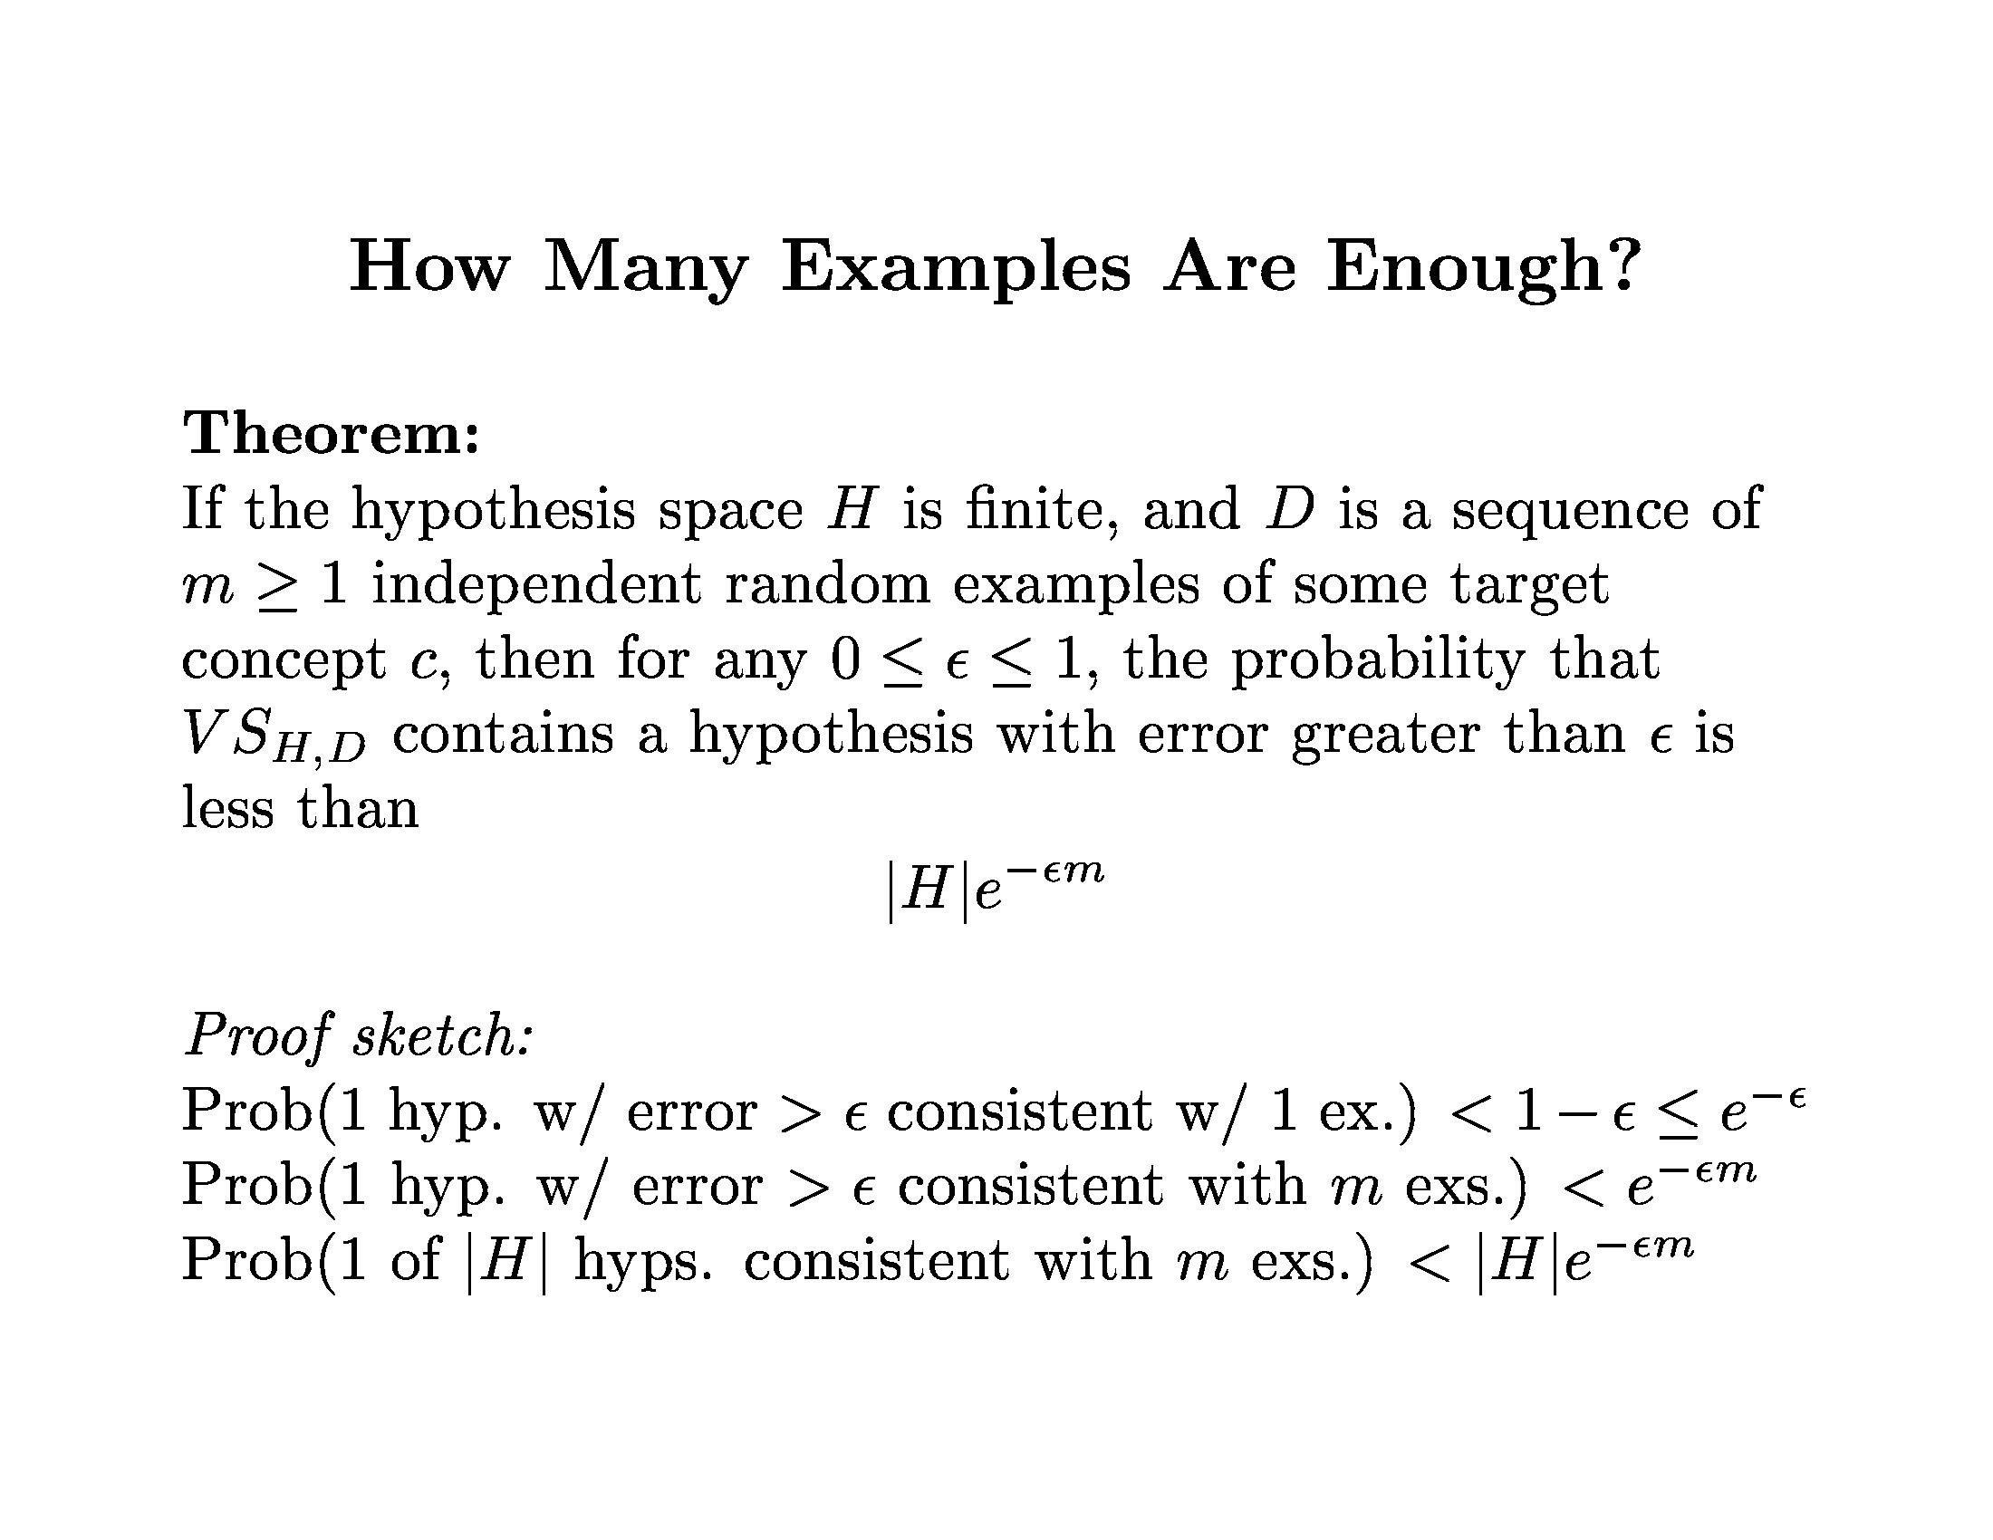
Learning Theory

Slide 24
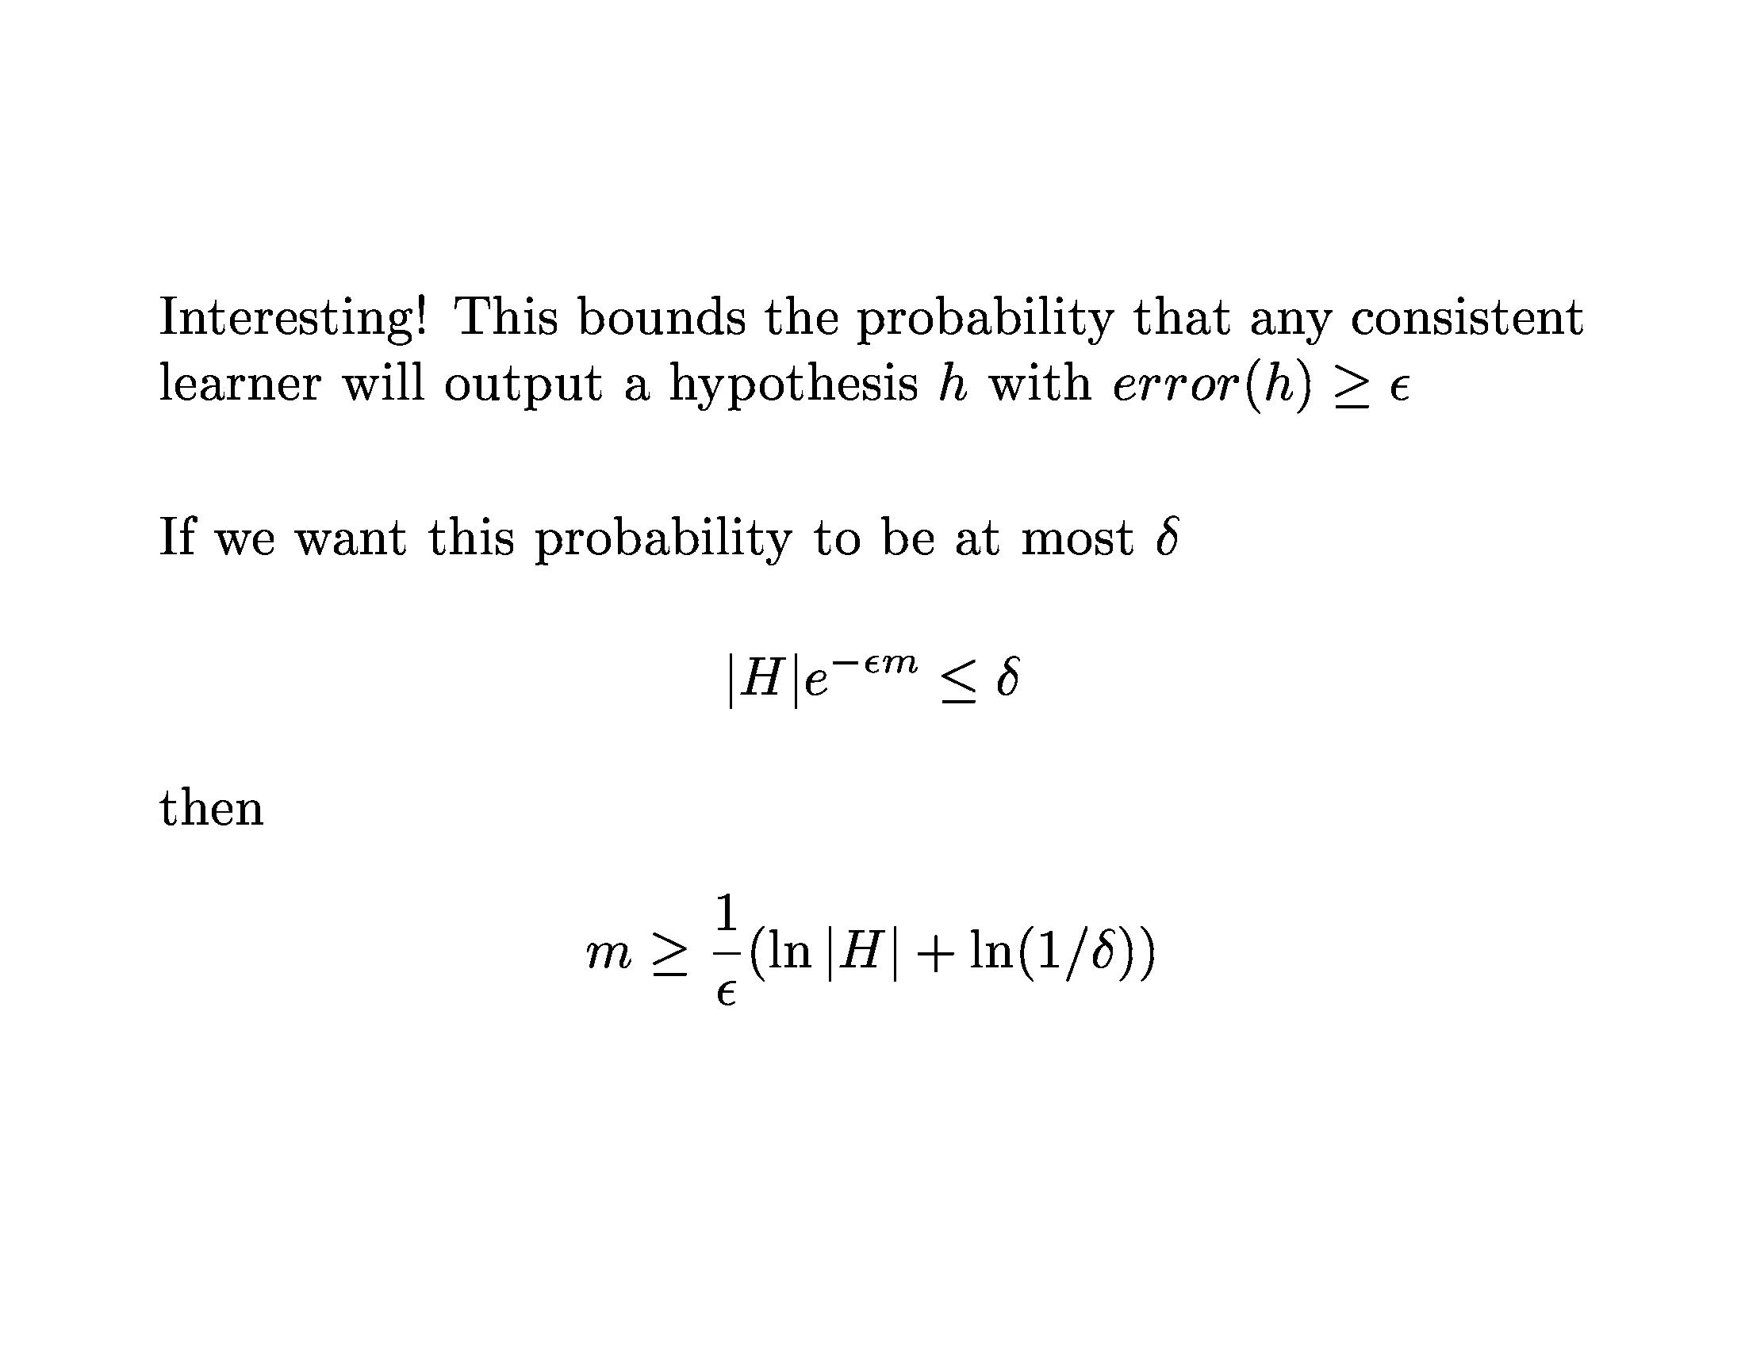
Learning Theory

Slide 25
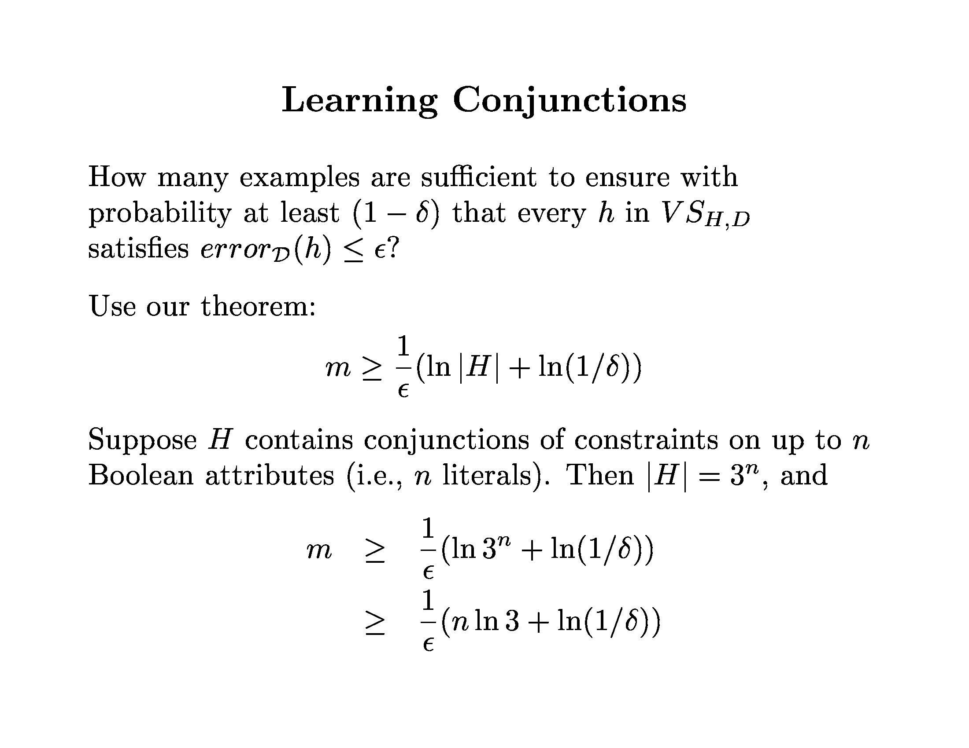
Learning Theory

Slide 26
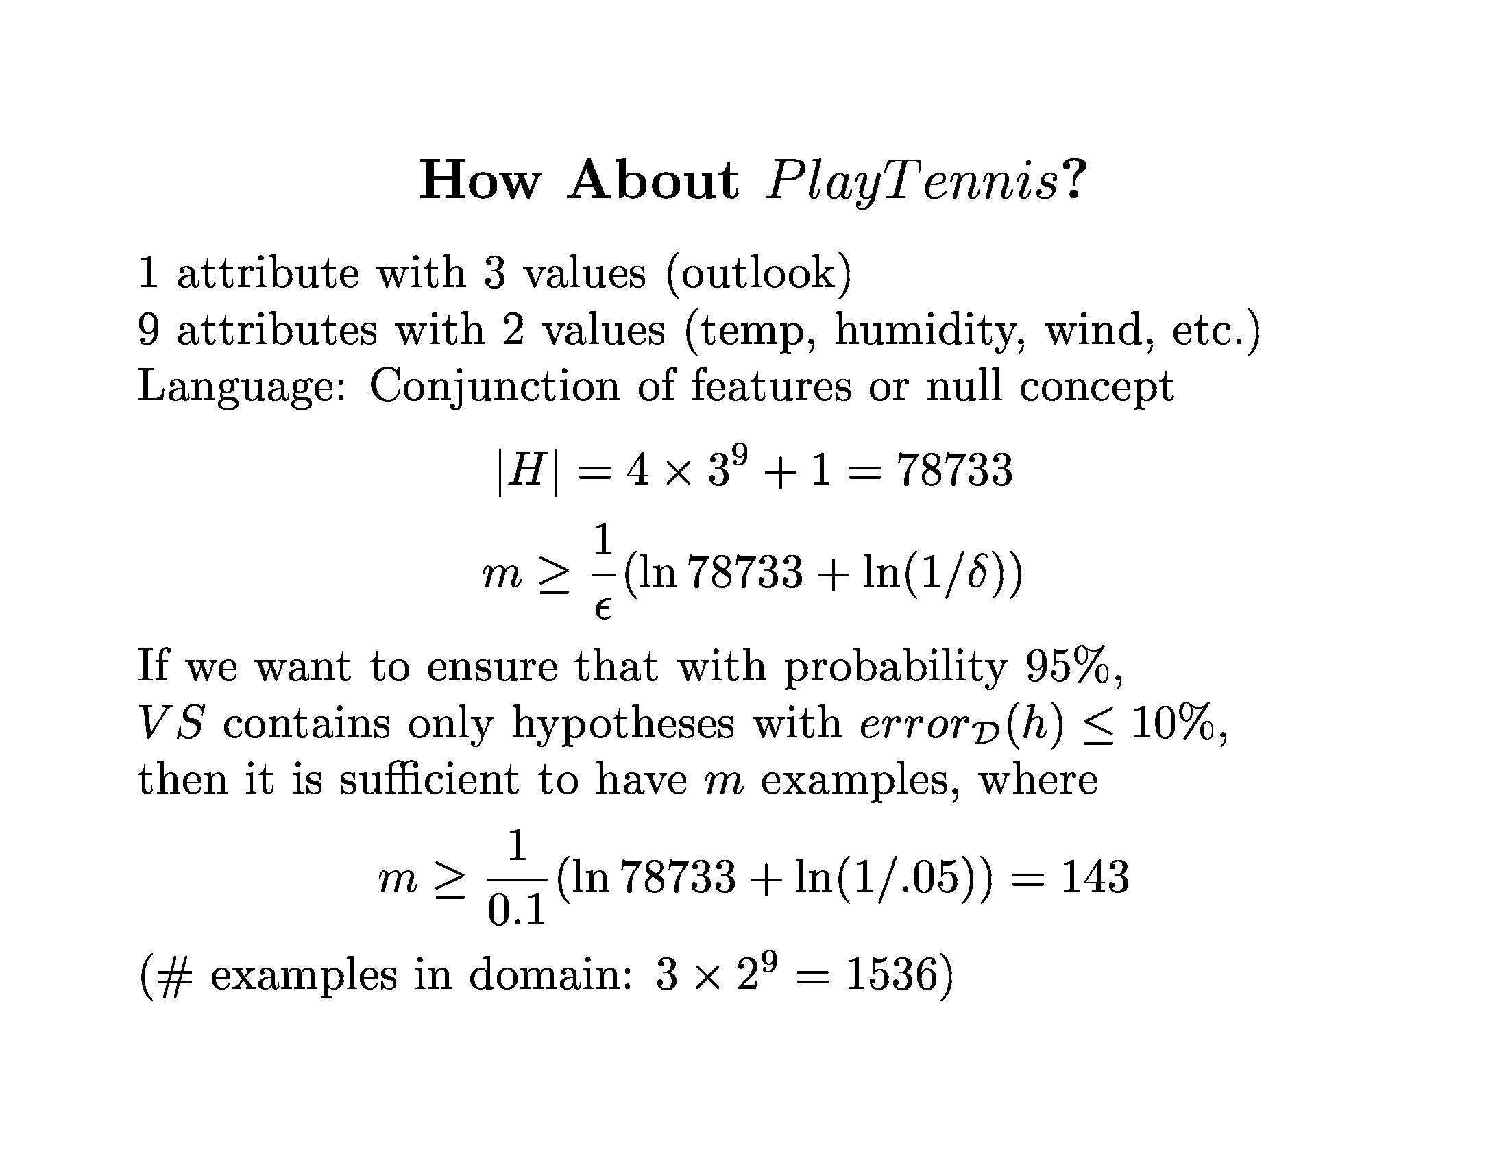
Learning Theory

Slide 27
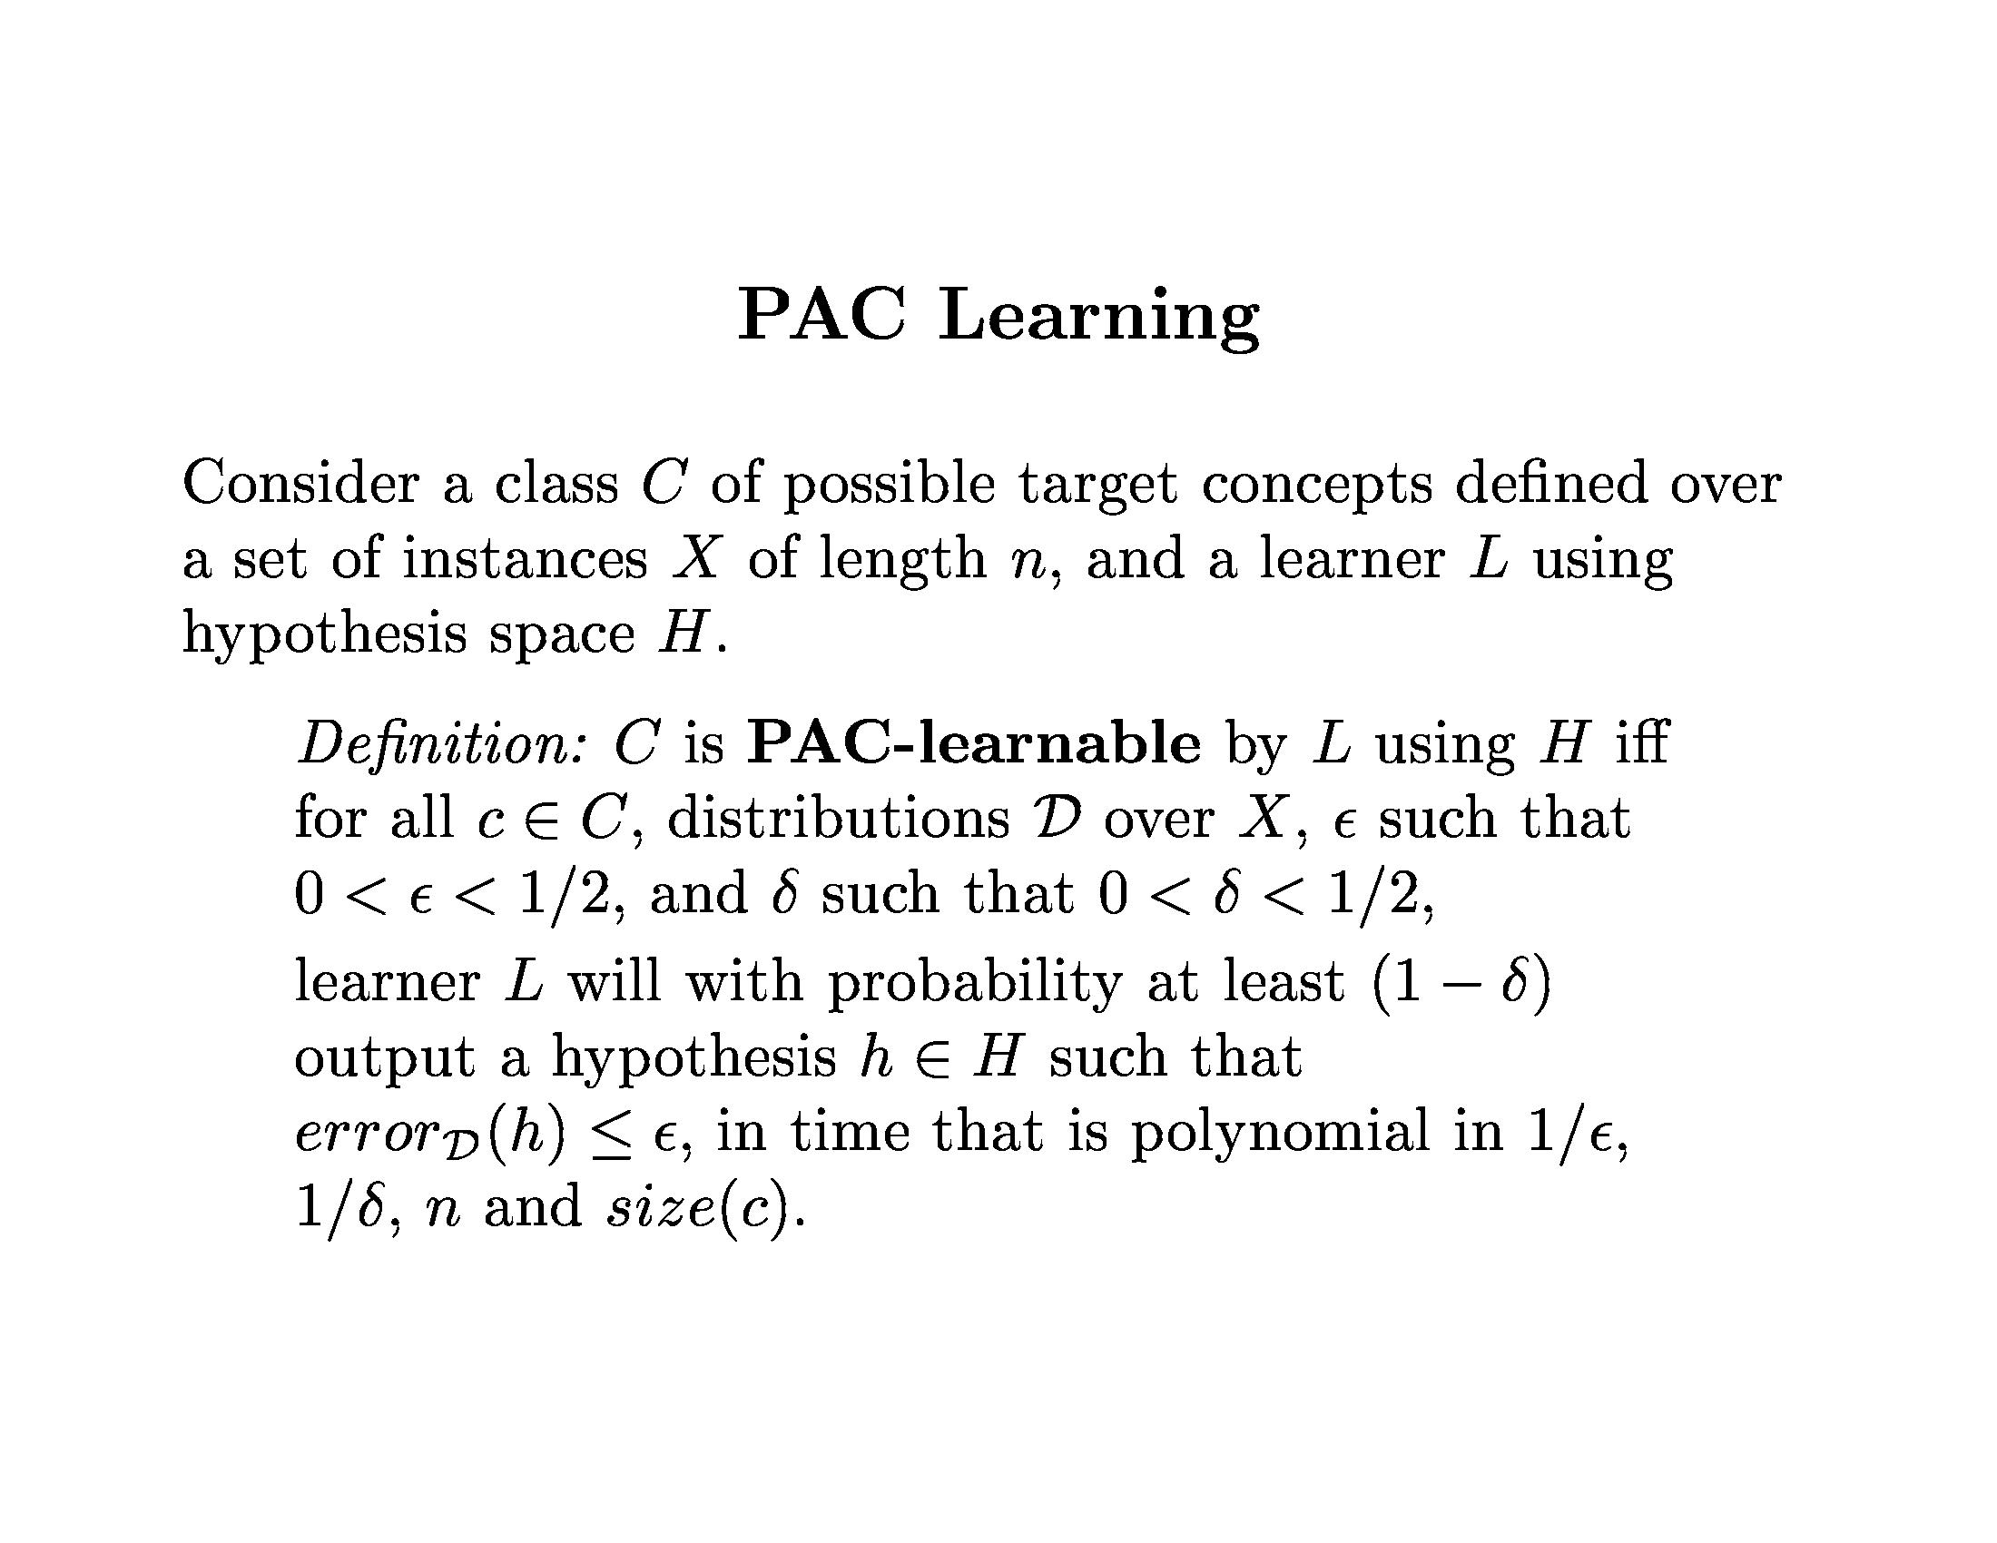
Learning Theory

Slide 28
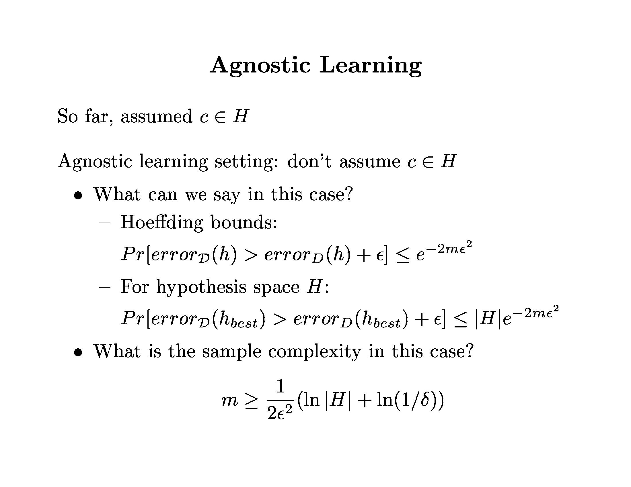
Learning Theory

Slide 29
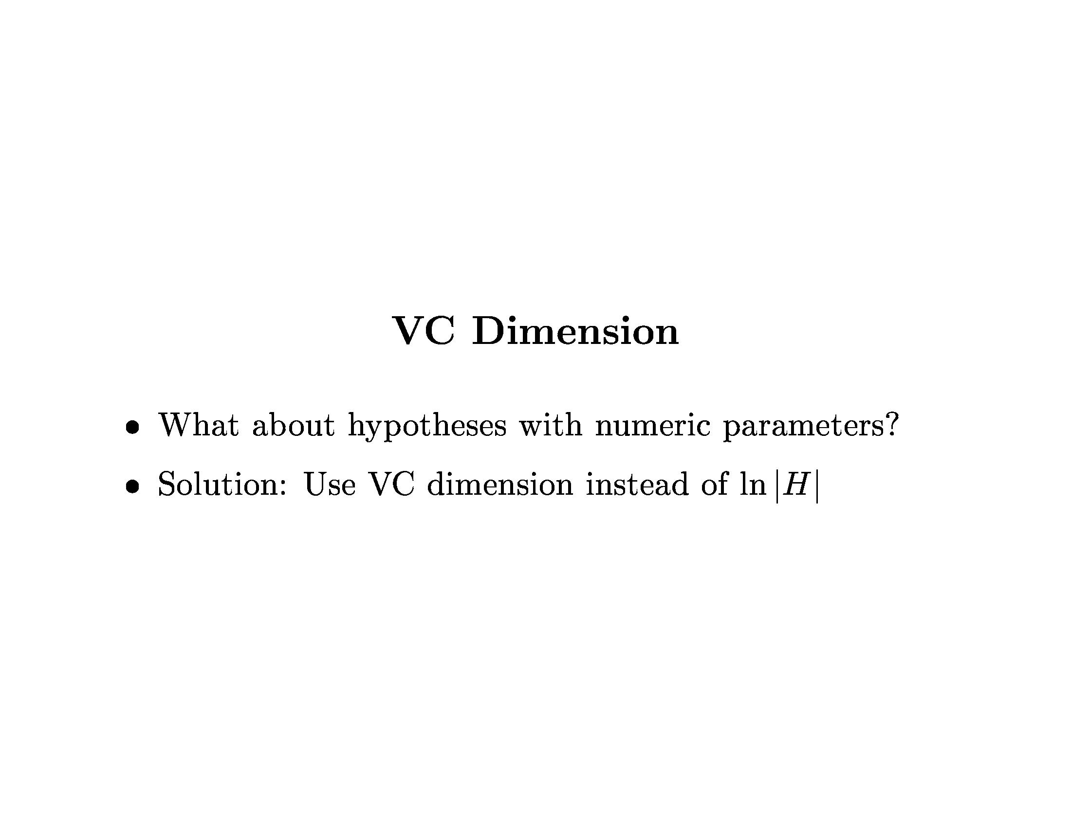
Learning Theory

Slide 30
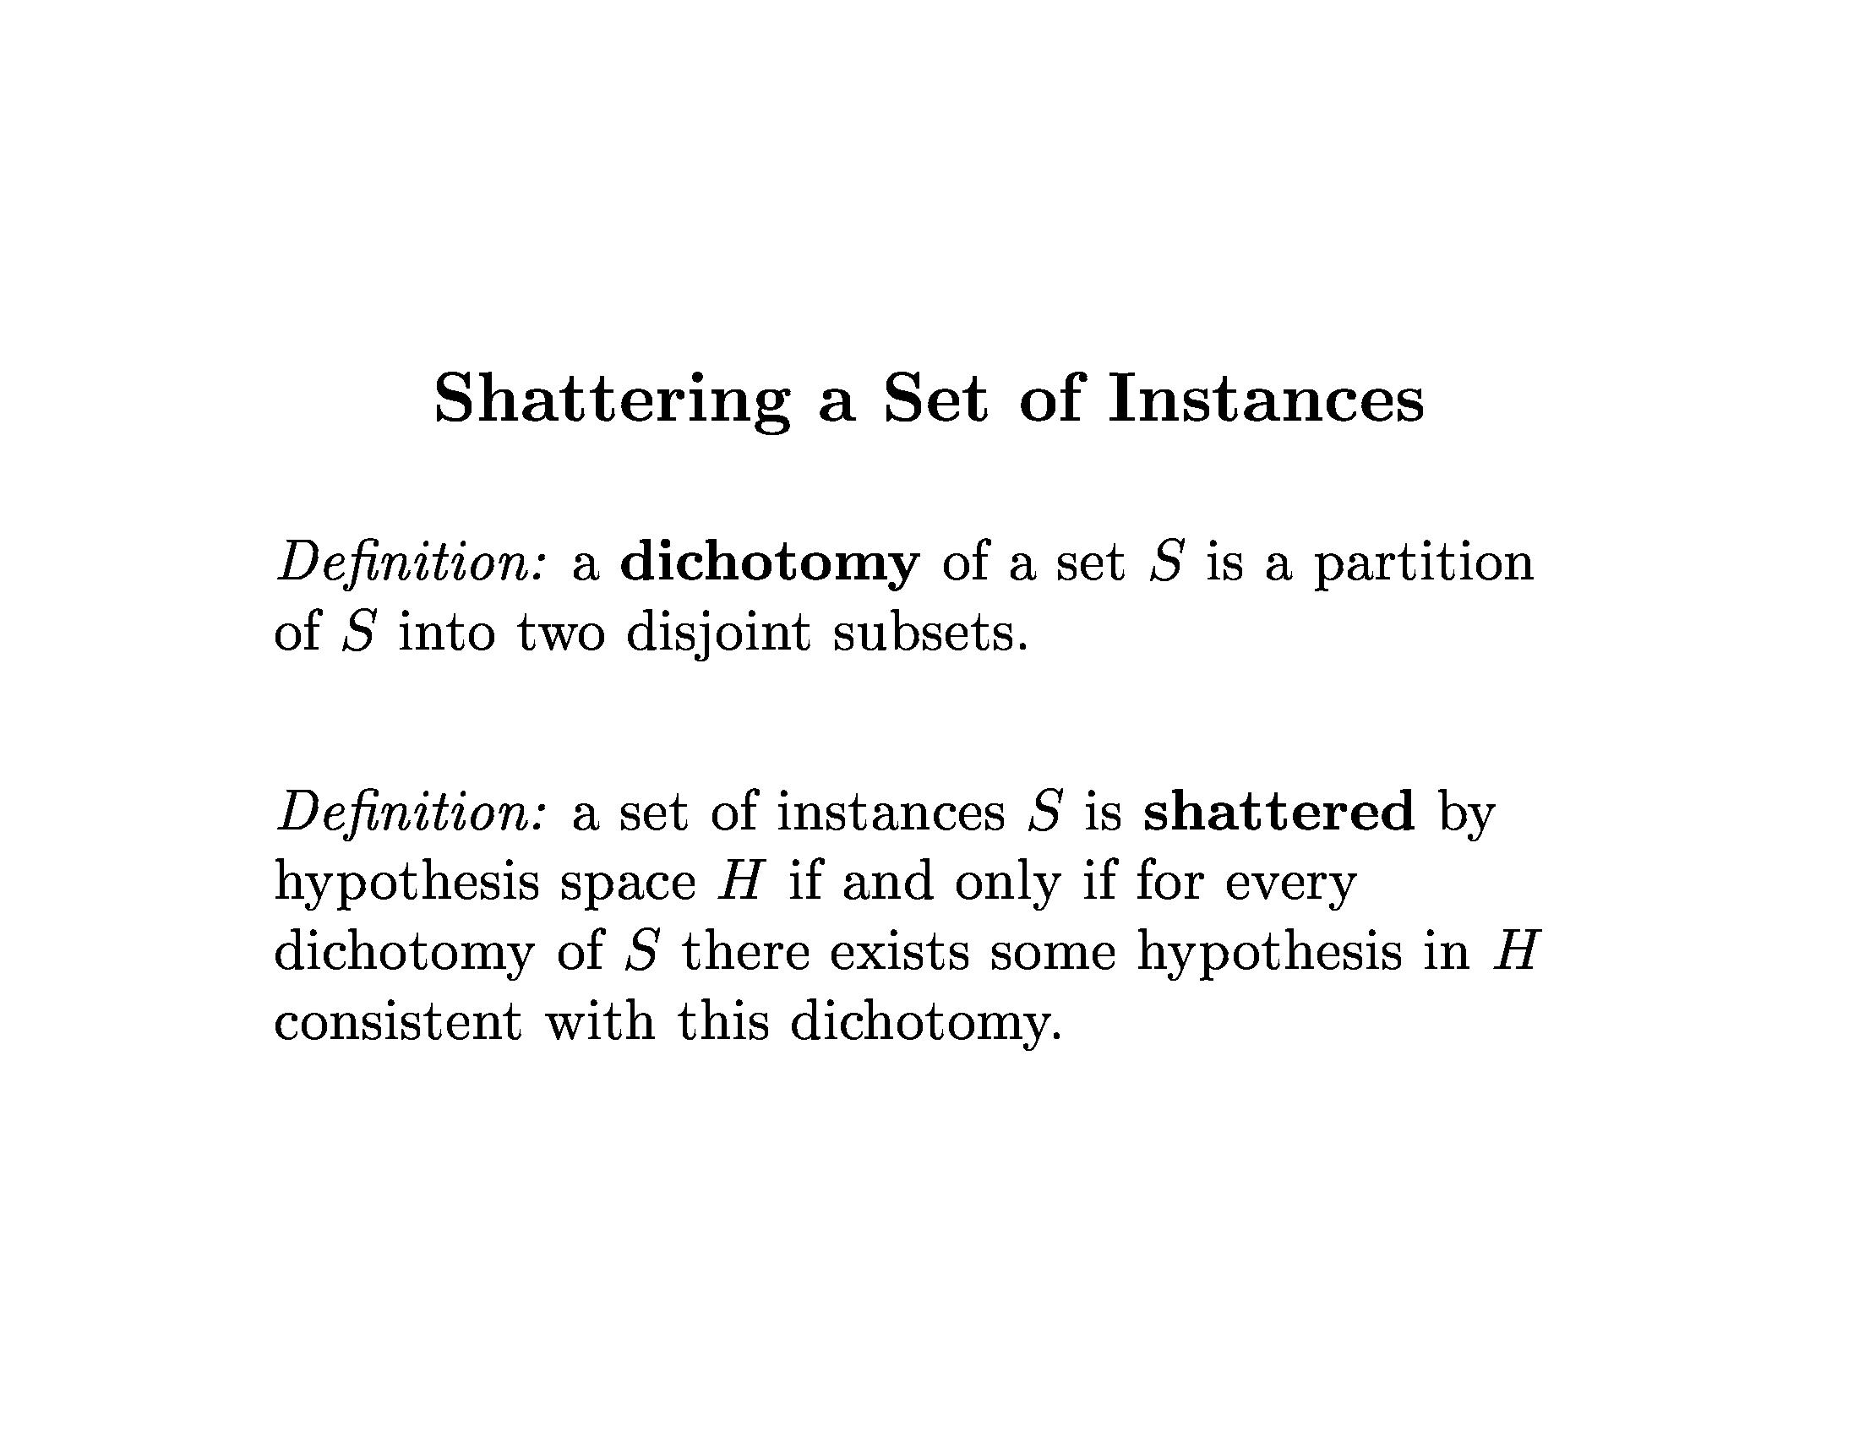
Learning Theory

Slide 31
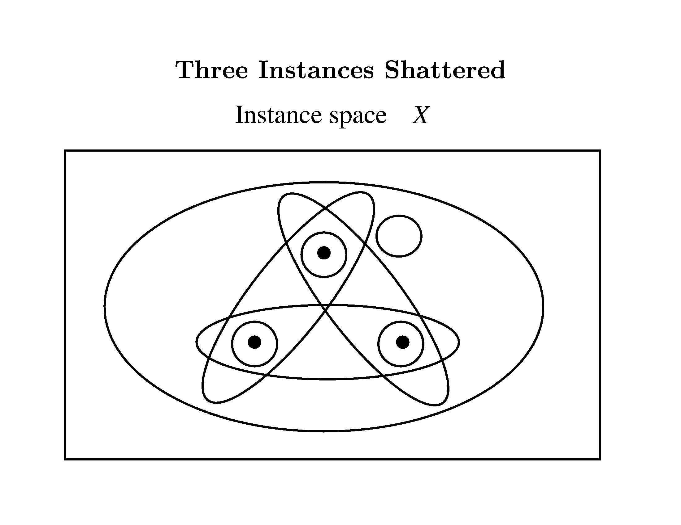
Learning Theory

Slide 32
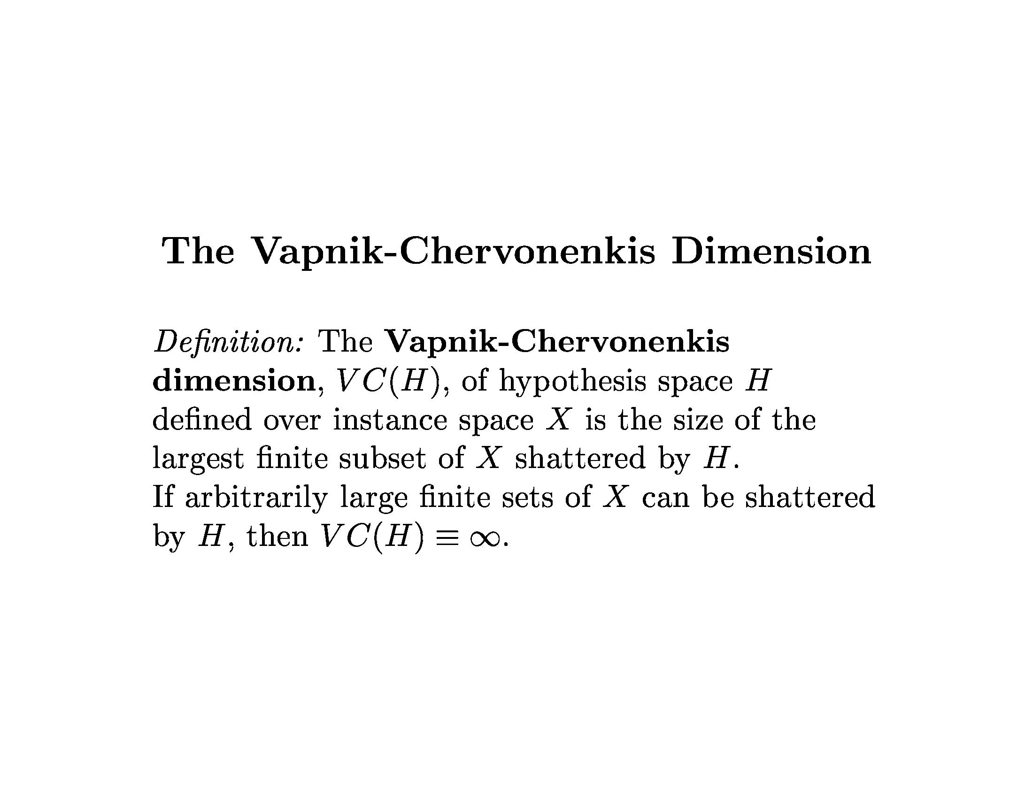
Learning Theory

Slide 33
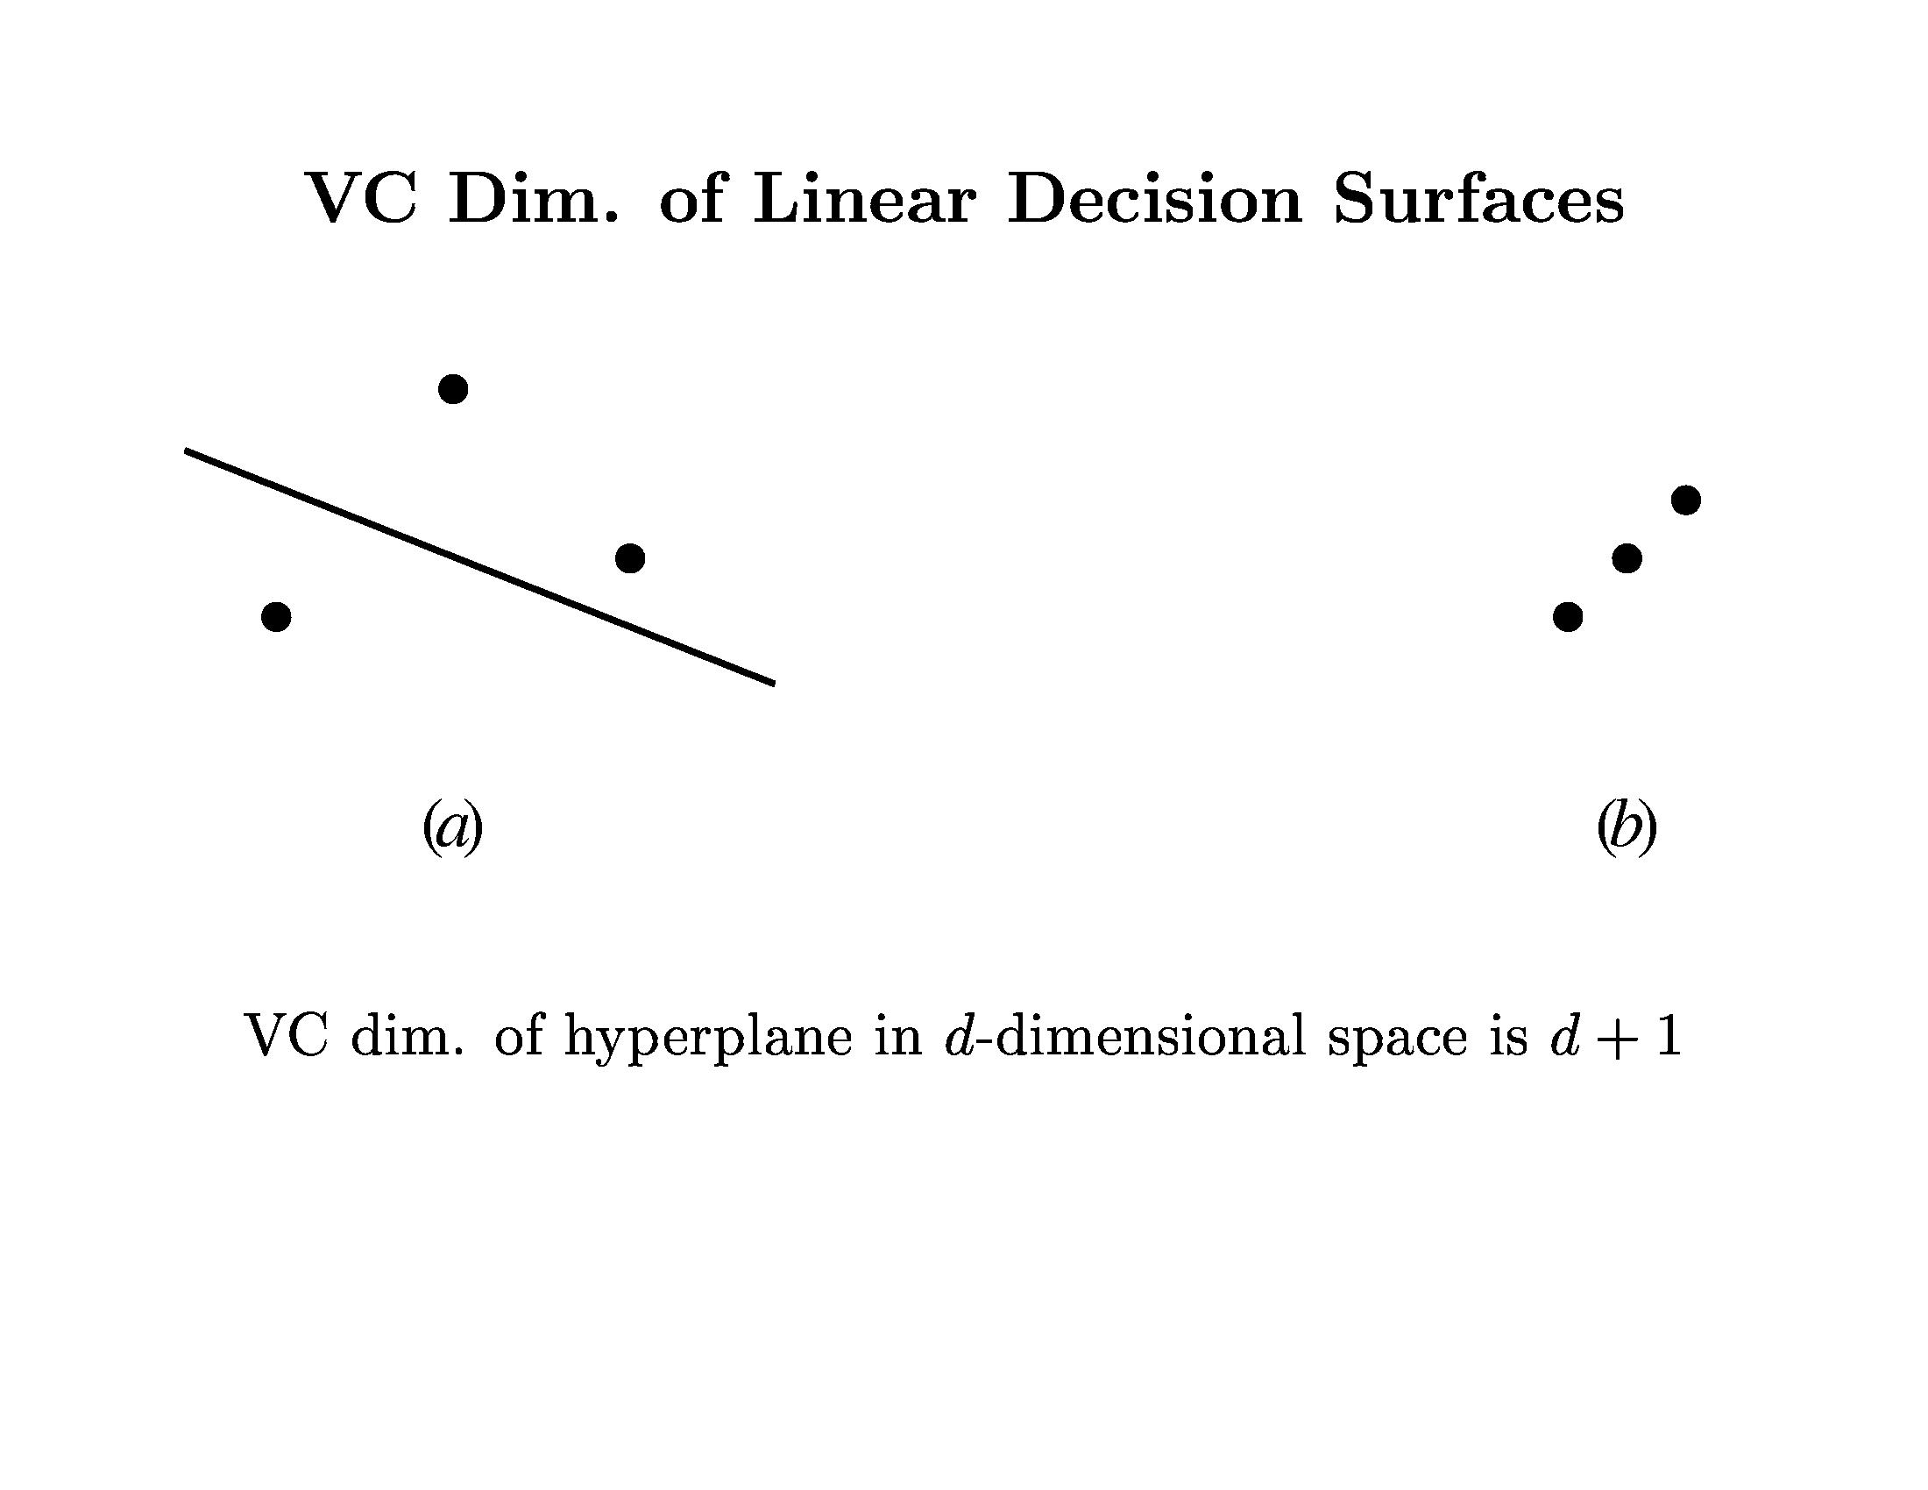
Learning Theory

Slide 34
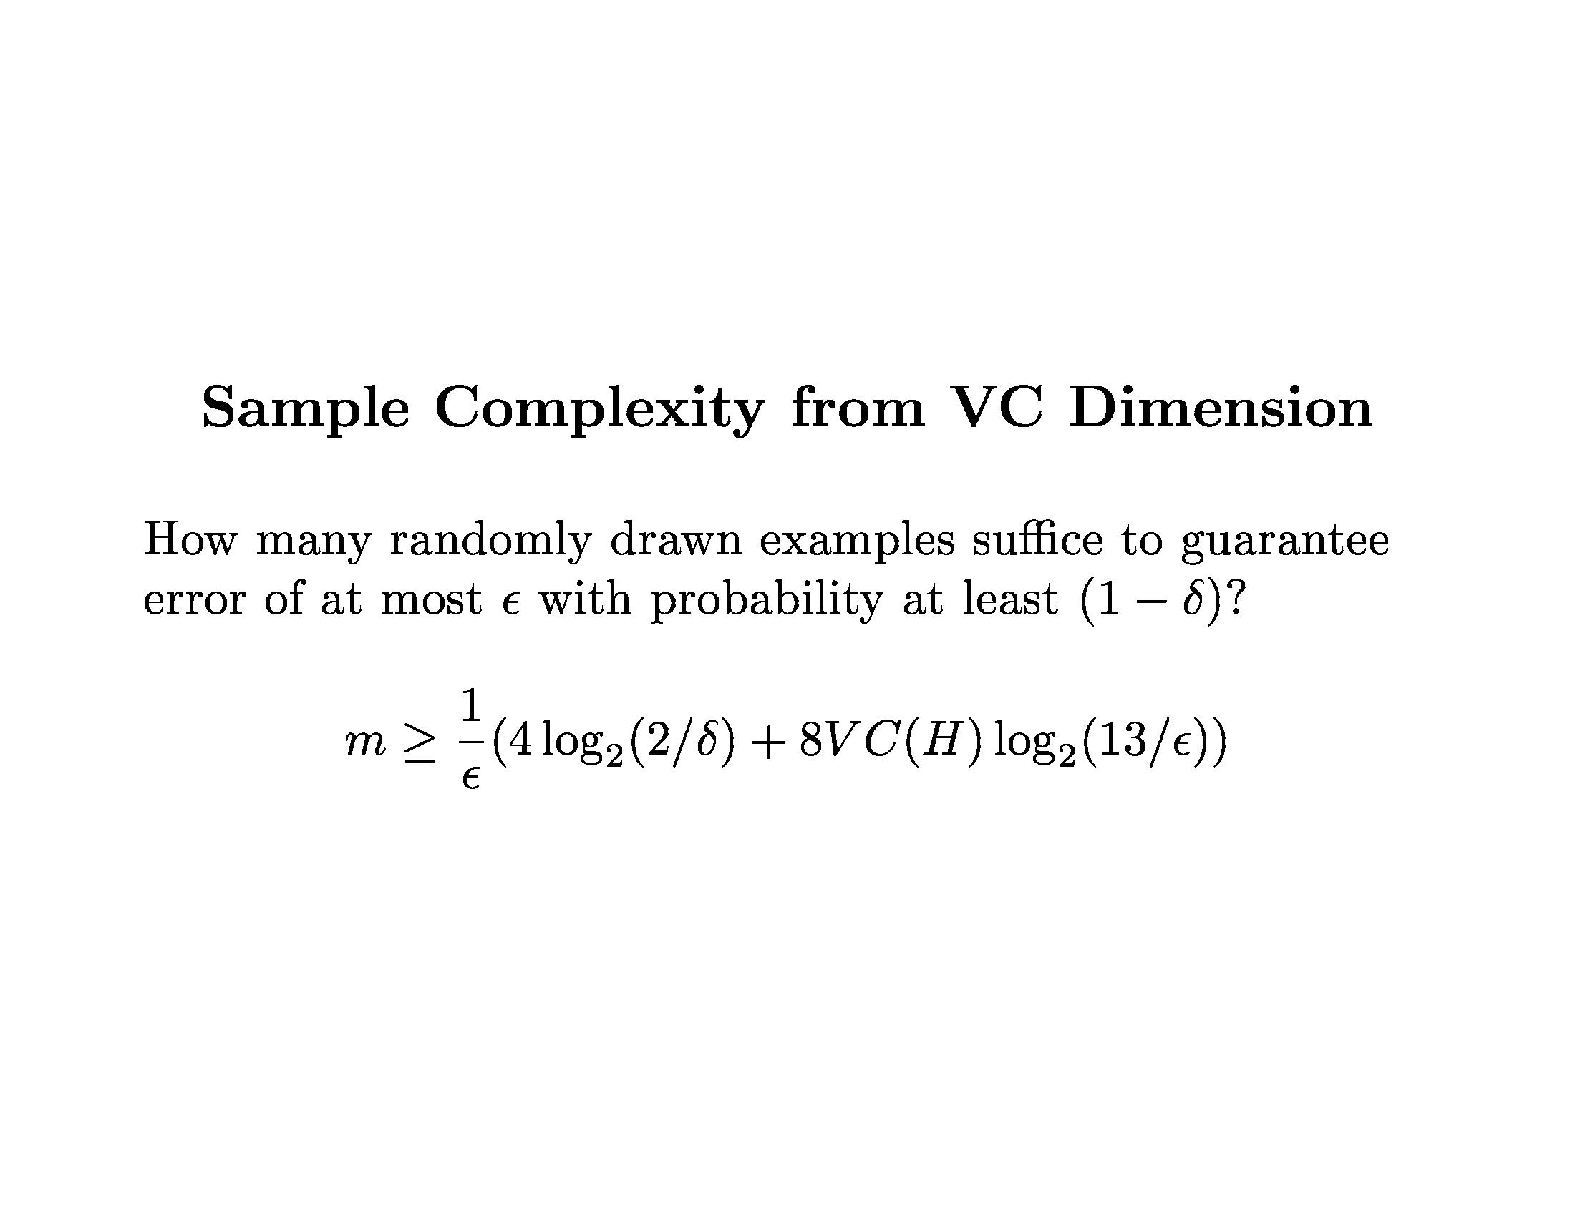
Learning Theory

Slide 35
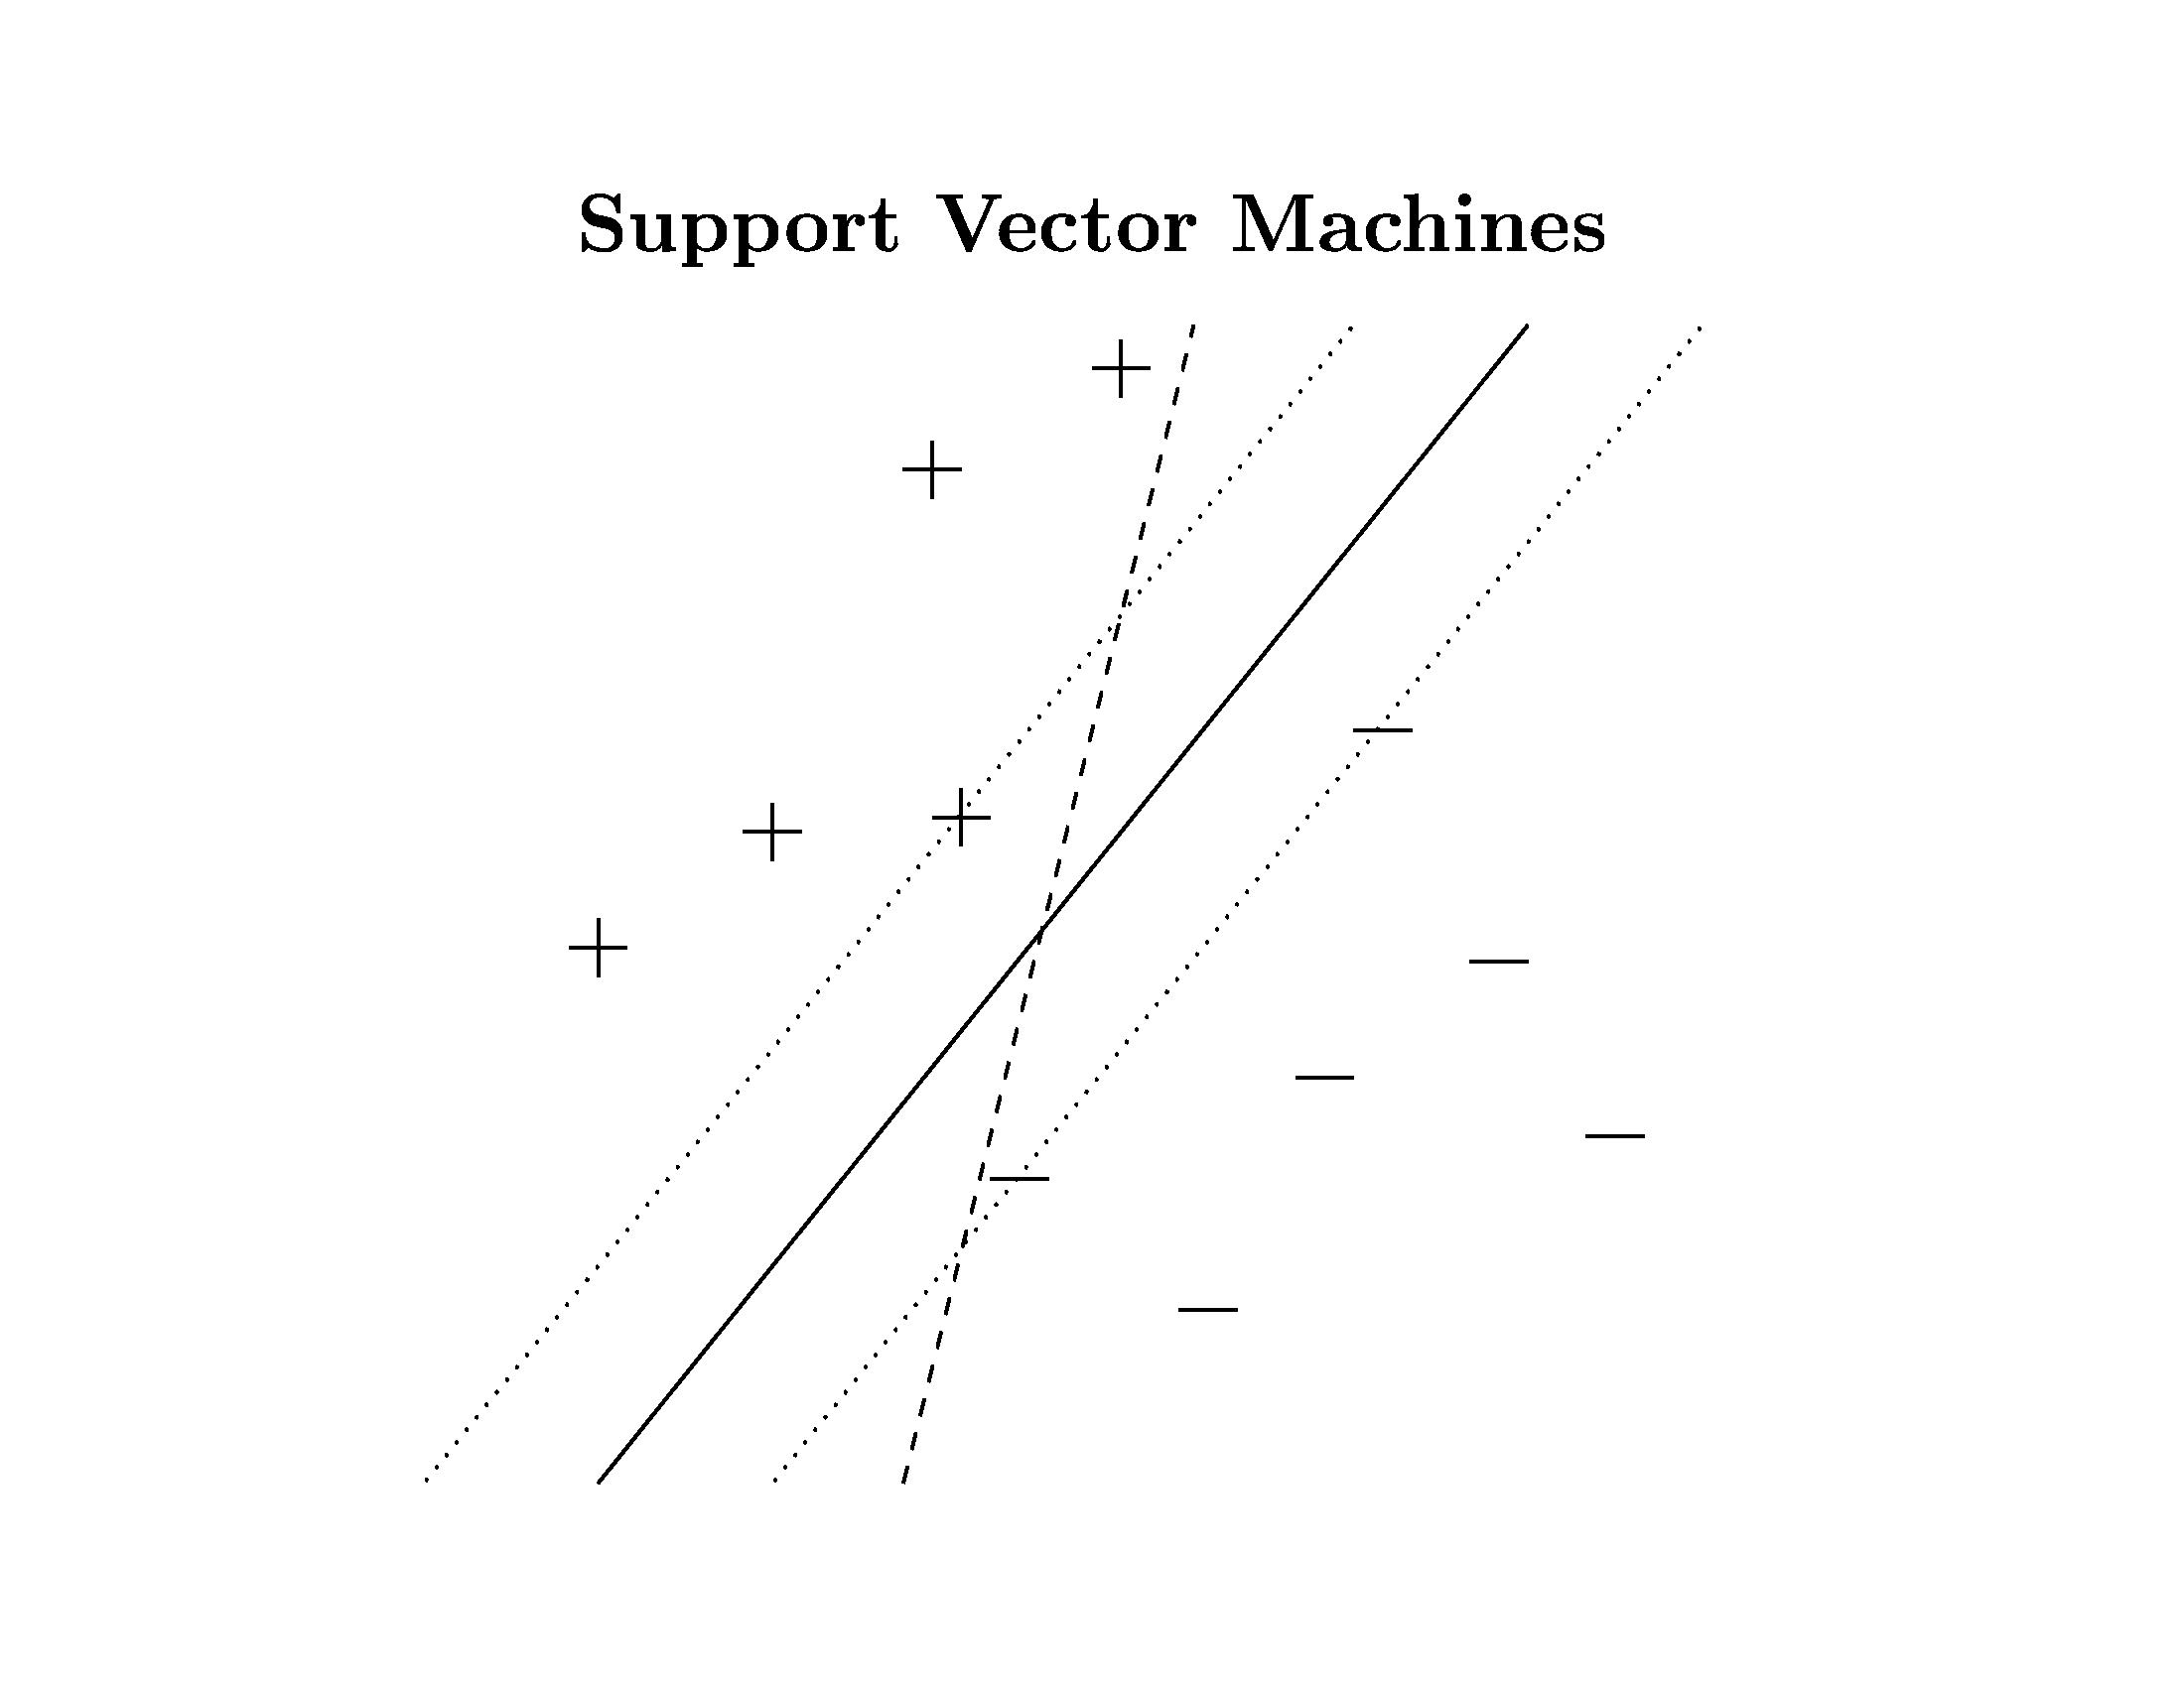
Learning Theory

Slide 36
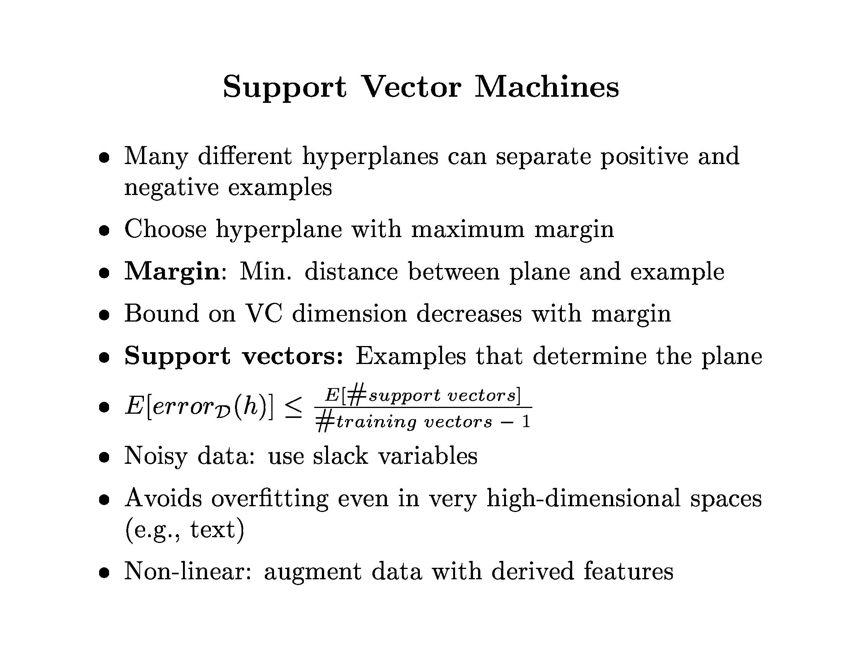
Learning Theory

Slide 37
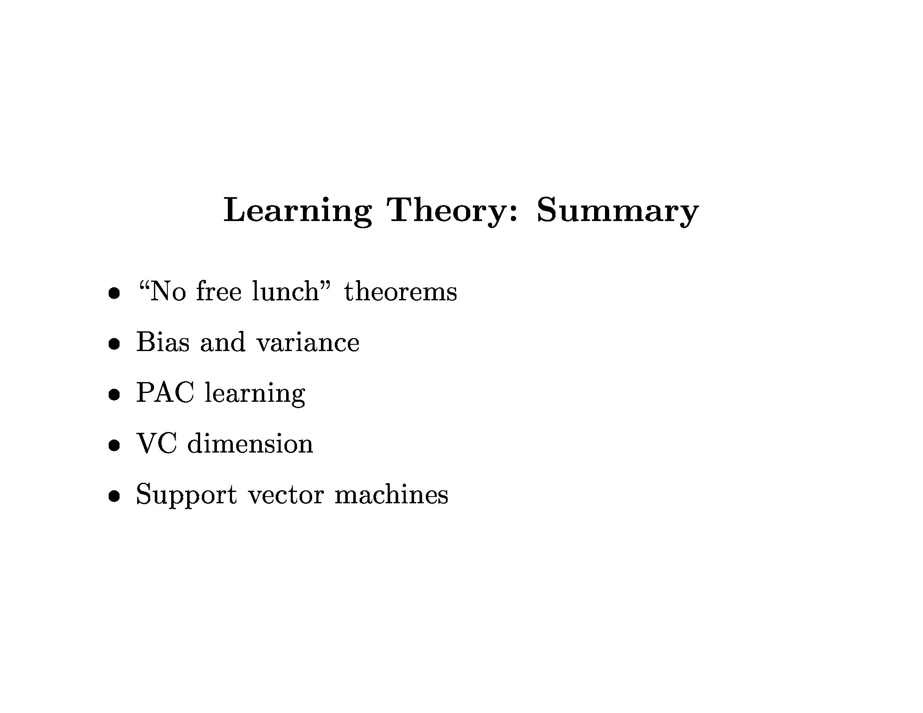
Learning Theory

